Slide 1
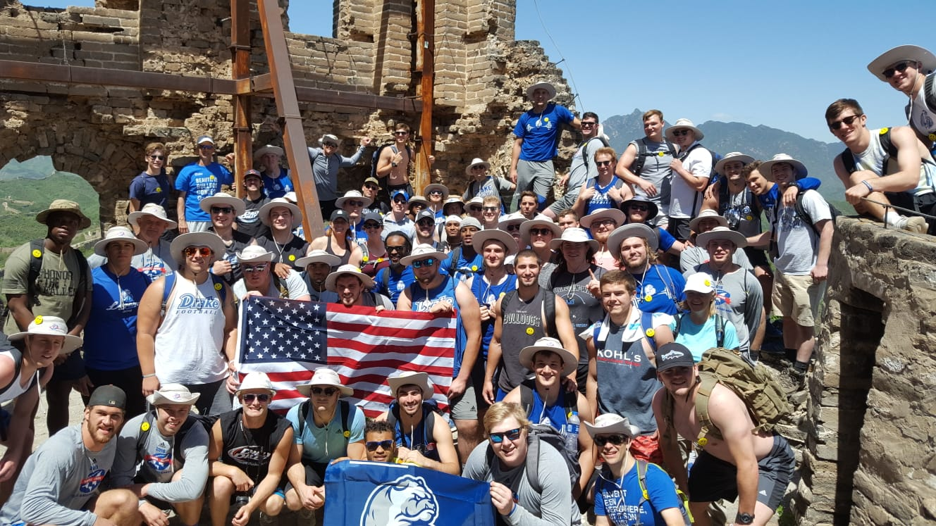


USA-China & American Football
Celebrating 40 Years of Diplomatic Relations in 2019

Slide 2
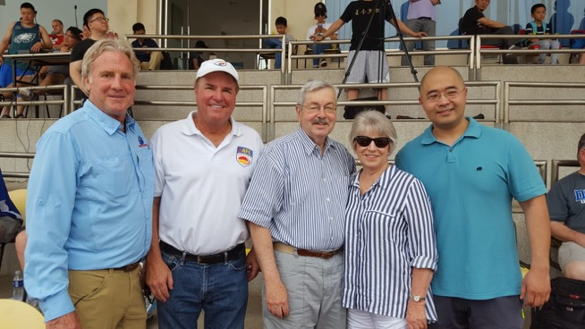


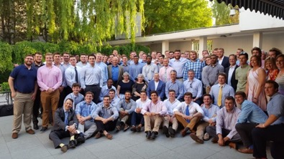

U.S. Ambassador to China Terry Branstad, a former long-serving Governor of Iowa, welcomed visitors from drake university to to his residence and attended the first-ever ncaa d-I football game on Chinese soil.

Slide 3
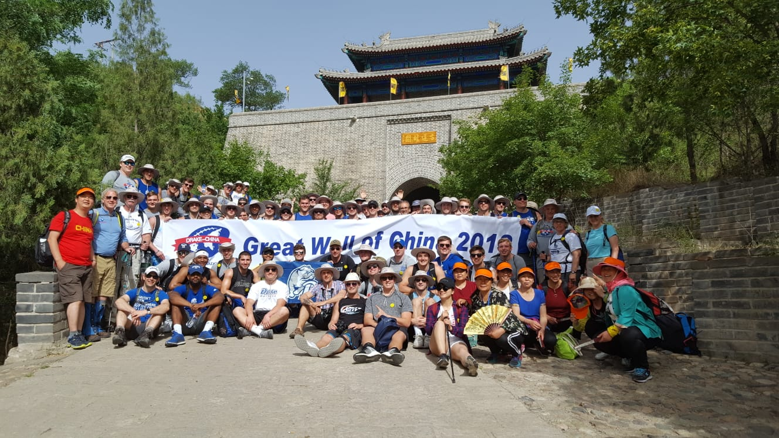


Slide 5
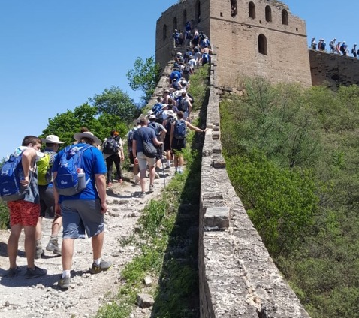
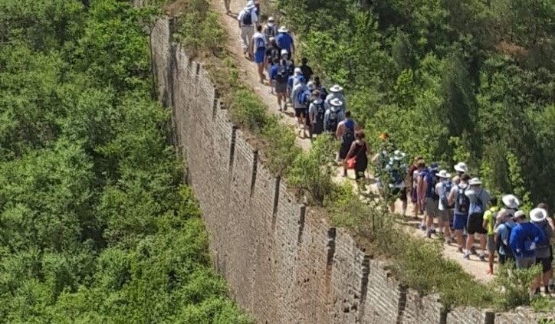
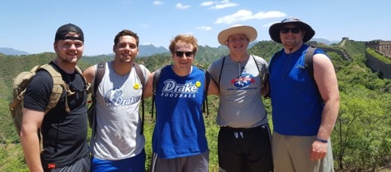
Hiking the Gubeikou-Jinsanling section of the Great Wall, which is a challenging climb and takes about 8 hours to complete.
The landscapes and sights were breathtaking

Slide 6
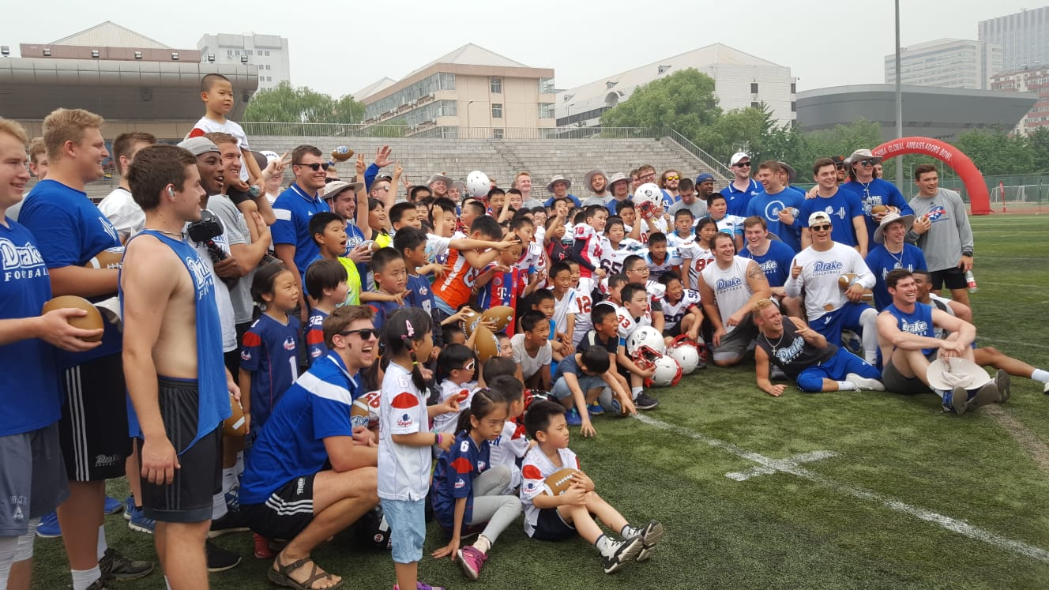
MEDIA COVERAGE
BEIJING YOUTH CLINIC

Slide 7
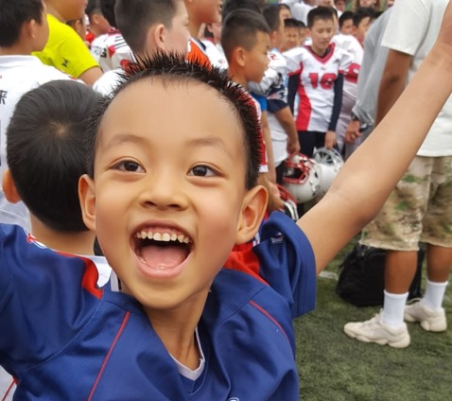
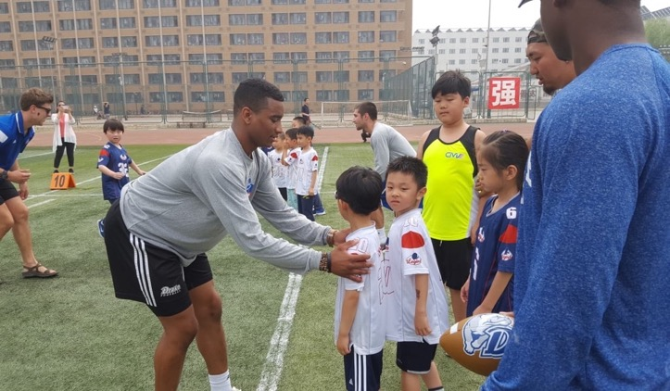
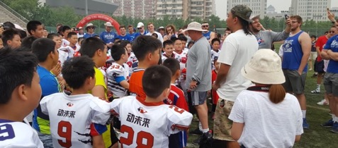
250 youngsters were treated to a hands-on coaching session with enthusiastic players and coaches

Slide 8
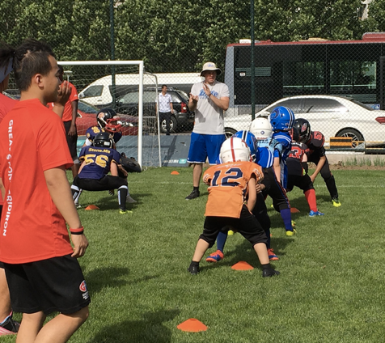
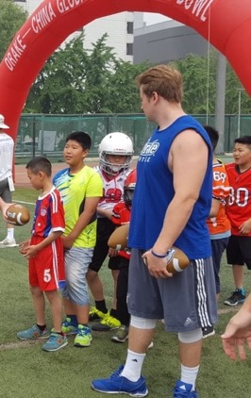
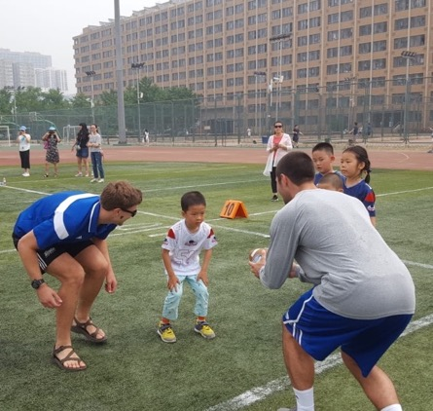
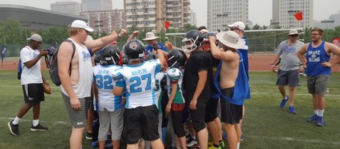
Chinese youth players and coaches are AS eager to learn about our sport through clinics as by playing against traveling opposition

Slide 9
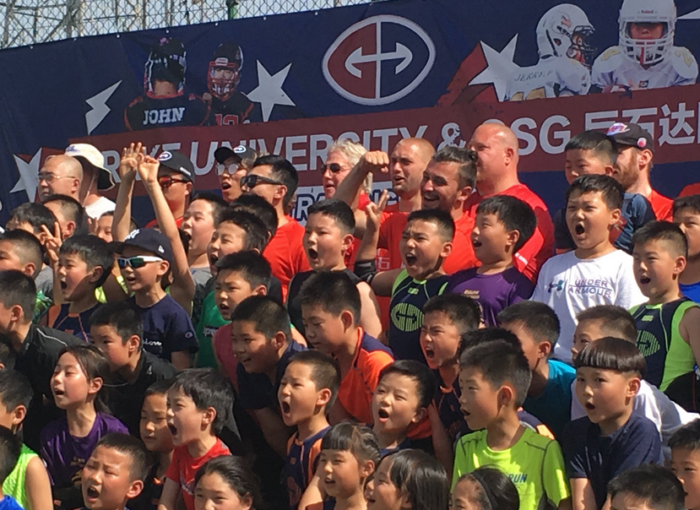


Slide 10

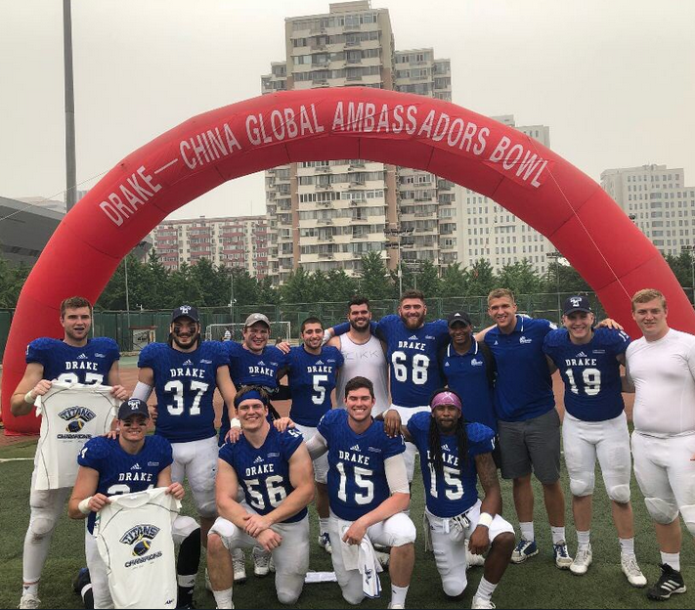

Slide 11
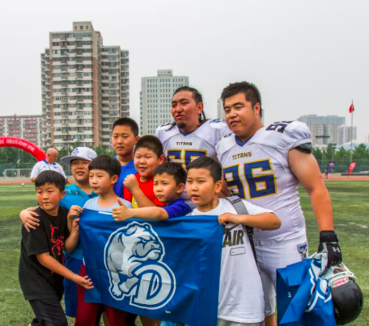
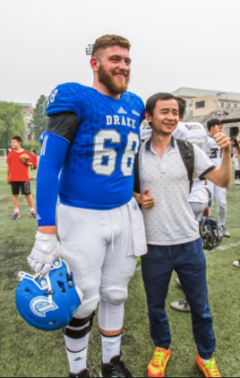
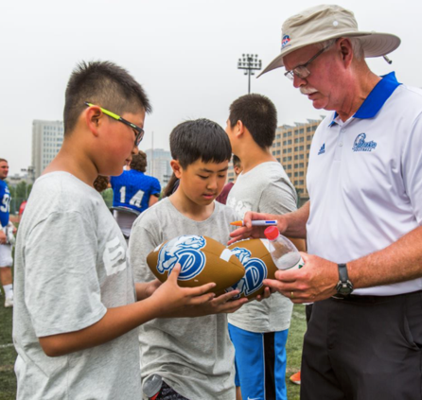
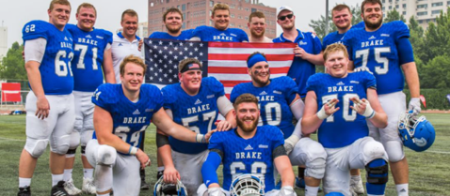
The American visitors won as expected on gameday, but afterwards, everyone was a winner

Slide 12
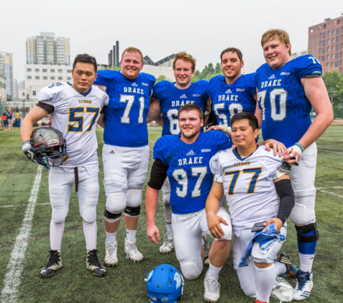
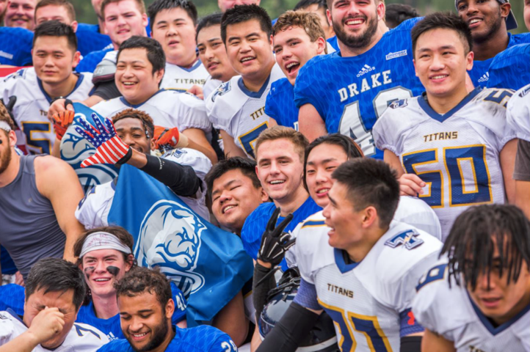
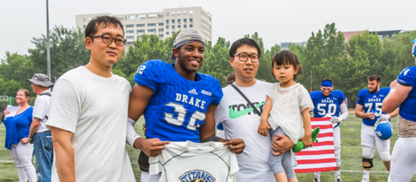
Friends for life!

Slide 13
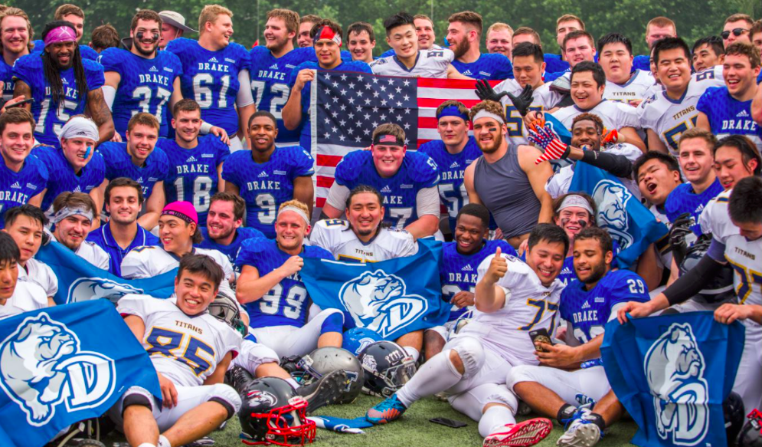

Slide 14
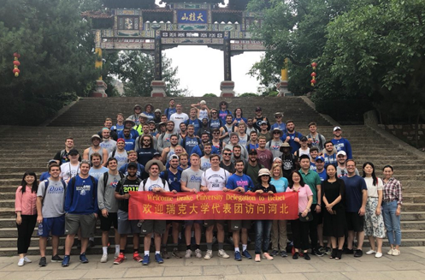
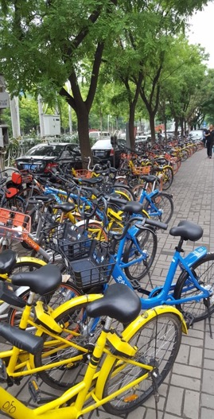
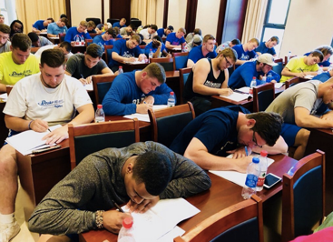
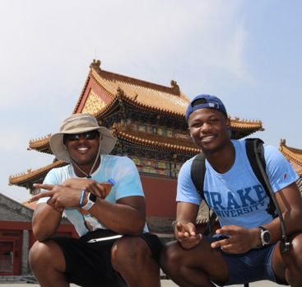
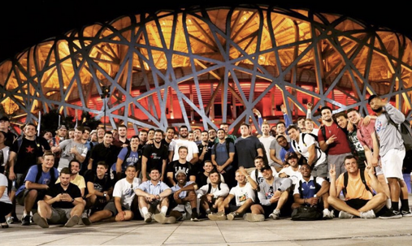
Sightseeing & education

Slide 15
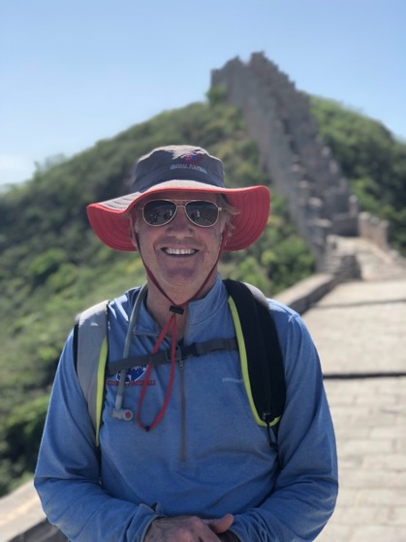
Create a legacy
Contact:
Patrick Steenberge, Founder & President
Global Football
Patrick@GlobalFootball.com
817.219.7274
www.GlobalFootball.com

