Slide 1




Public Relations Summary

Slide 2
Goal & Objectives
Provide a full media relations service for the first ever game of college football in Africa, community projects and climb
Achieve national U.S. TV and print media coverage
Provide resources and information to enable Drake University and CONADEIP to generate media coverage in their markets
Work alongside Tanzanian media representative to create coverage in Africa
Integrate sponsor and partner brands into media coverage
Promote the Global Football, Drake and CONADEIP brands
Utilize social media outlets, specifically Facebook, Twitter and YouTube
Provide broadcast services to ITV and production company
Publicize relationships nurtured with Tanzanian officials

Slide 3
Hits
U.S. national TV exposure on ESPN Sportscenter and ESPN First Take
U.S. national print coverage in ESPN The Magazine (circulation 2 million, readership 15.3 million)
More than 100 newspaper features, including USA Today, New York Times, Boston Globe and Los Angeles Times with a circulation total of 20 million
Game coverage on three Des Moines TV news stations local to Drake
Wire story nationally through Associated Press and internationally via Reuters
Worldwide radio feature through BBC World Service
Prominent features on YahooSports.com and SI.com
Sourced experienced presenter to call game for ITV broadcast
All media events attended by more than 15 Arusha and national African media
Blanket media coverage among Arusha media and further afield
International TV feature on ESPN Deportes
Social media presence on Facebook, Twitter and YouTube including live Tweets
Photos provided by Chris Donahue
Des Moines Register blog by E.J. Walter

Slide 4
Misses
Satellite feed unavailable due to geographical restrictions
Insufficient infrastructure to provide a live webcast
Poor internet speed limited some media opportunities including the ability to send TV footage and live radio
National U.S. media did not travel to Tanzania (ESPN The Magazine considered sending a writer and photographer)
Despite encouraging U.S. national print media exposure, coverage could have been increased
Facebook numbers and integration with Drake and CONADEIP Facebook groups did not meet expectations

Slide 5
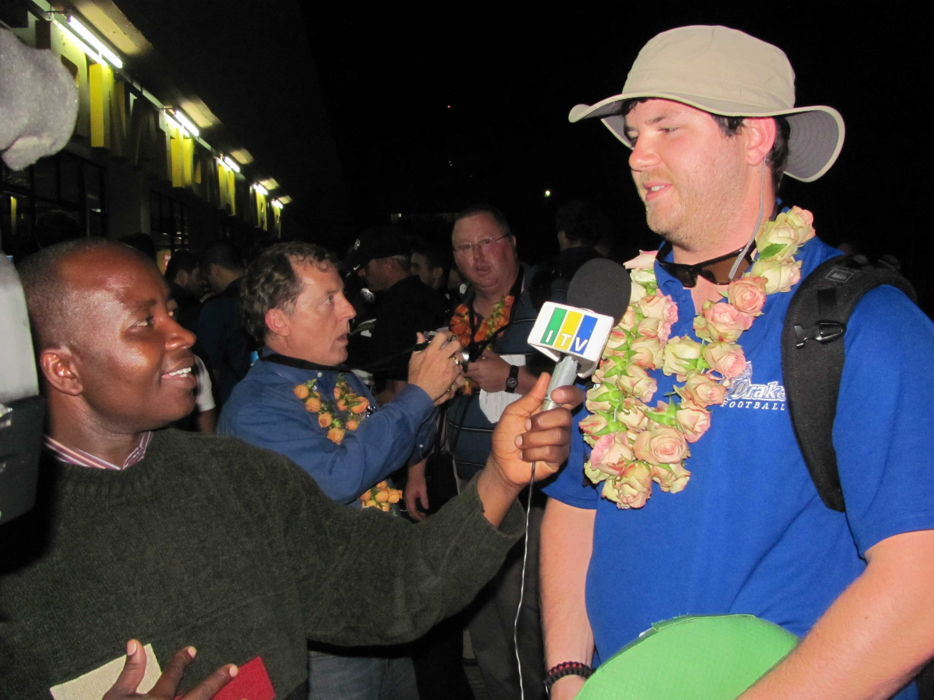
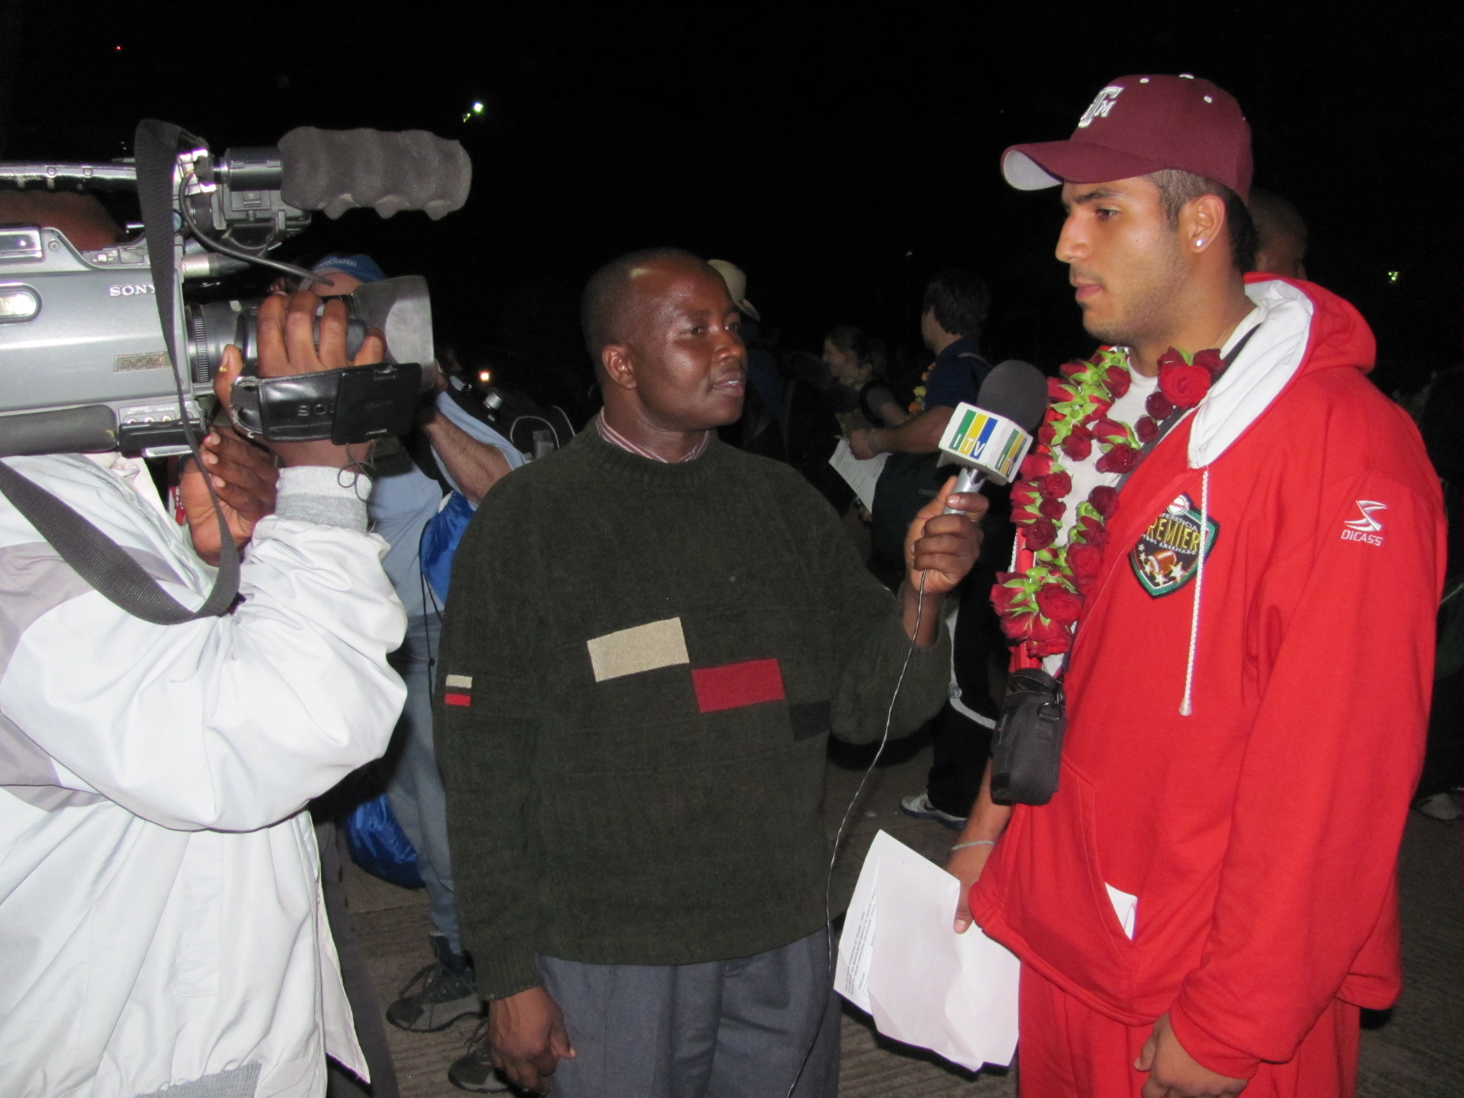
Team Arrivals
Players and coaches from both teams were made available to local Tanzanian media upon arrival on African soil
Quotes and photos were provided to U.S. media and websites
Strong social media coverage of arrivals, particularly YouTube flip video footage
ITV used footage to promote upcoming game broadcast
Sponsor TAHA received positive coverage from media reports having provided flower garlands to all arriving players, coaches and officials
Both teams were willing participants under the media spotlight after long flights

Slide 6
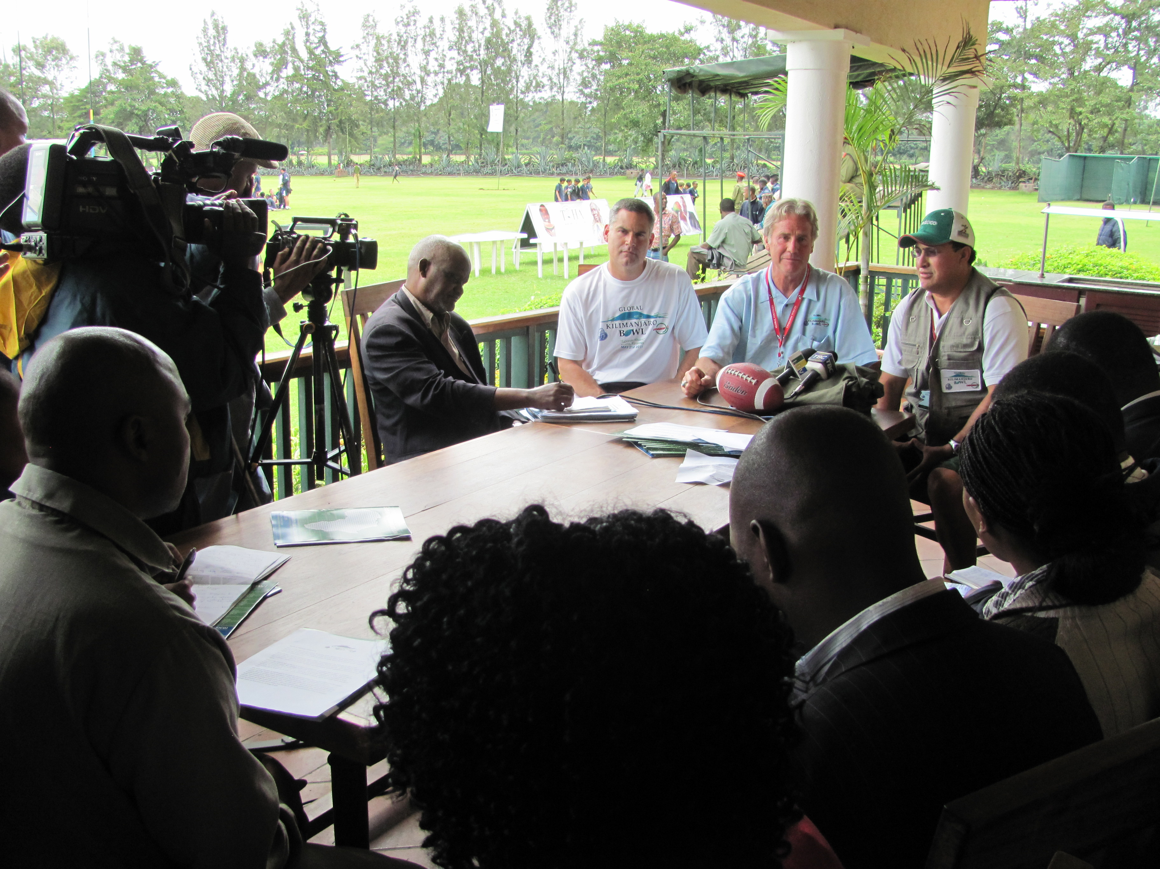
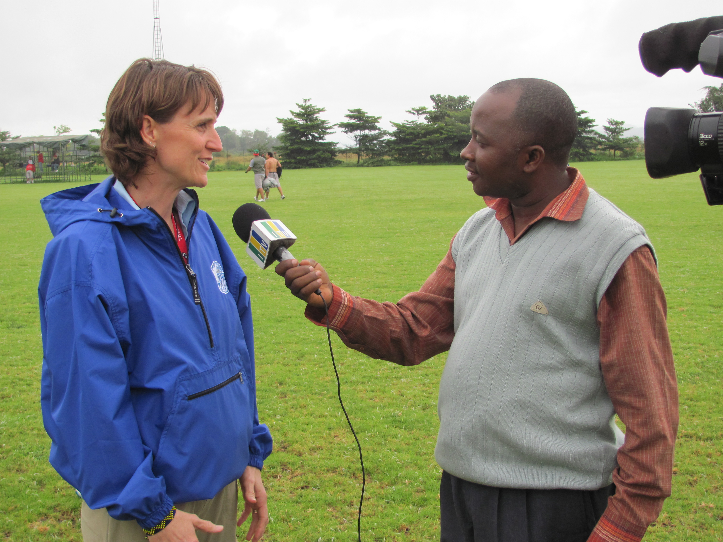
Practices & Clinics
Media had complete access to players, coaches and officials during practice sessions and coaching clinics at the TGT facility.
Participants willingly gave interviews
15 media outlets were represented at the official Kili Bowl press conference, their attendance arranged by Geofrey Erneo of the Tanzanian Tourist Board
Media in attendance included the Arusha Citizen, Guardian, Daily News, Hibari Leo, ITV, Star TV, Channel 10, Mwananchi, Majira, Nipashe, the Arusha Times and Triple A FM radio
TV presenter Mike Carlson was able to familiarize himself with both teams at practice
Positive images generated by the coaching clinic
Comprehensive social media coverage

Slide 7
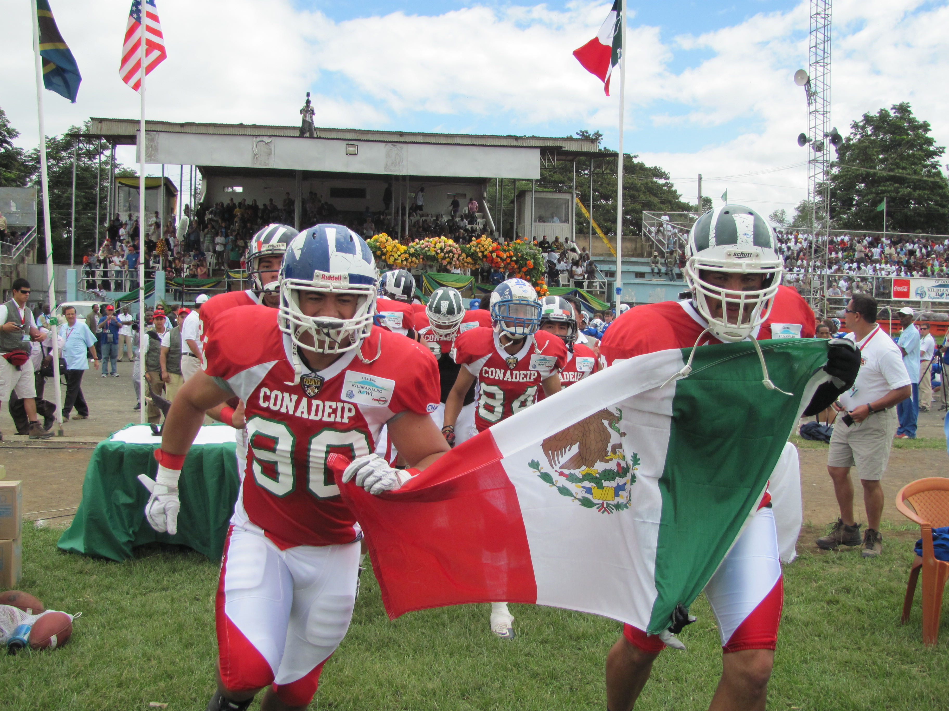
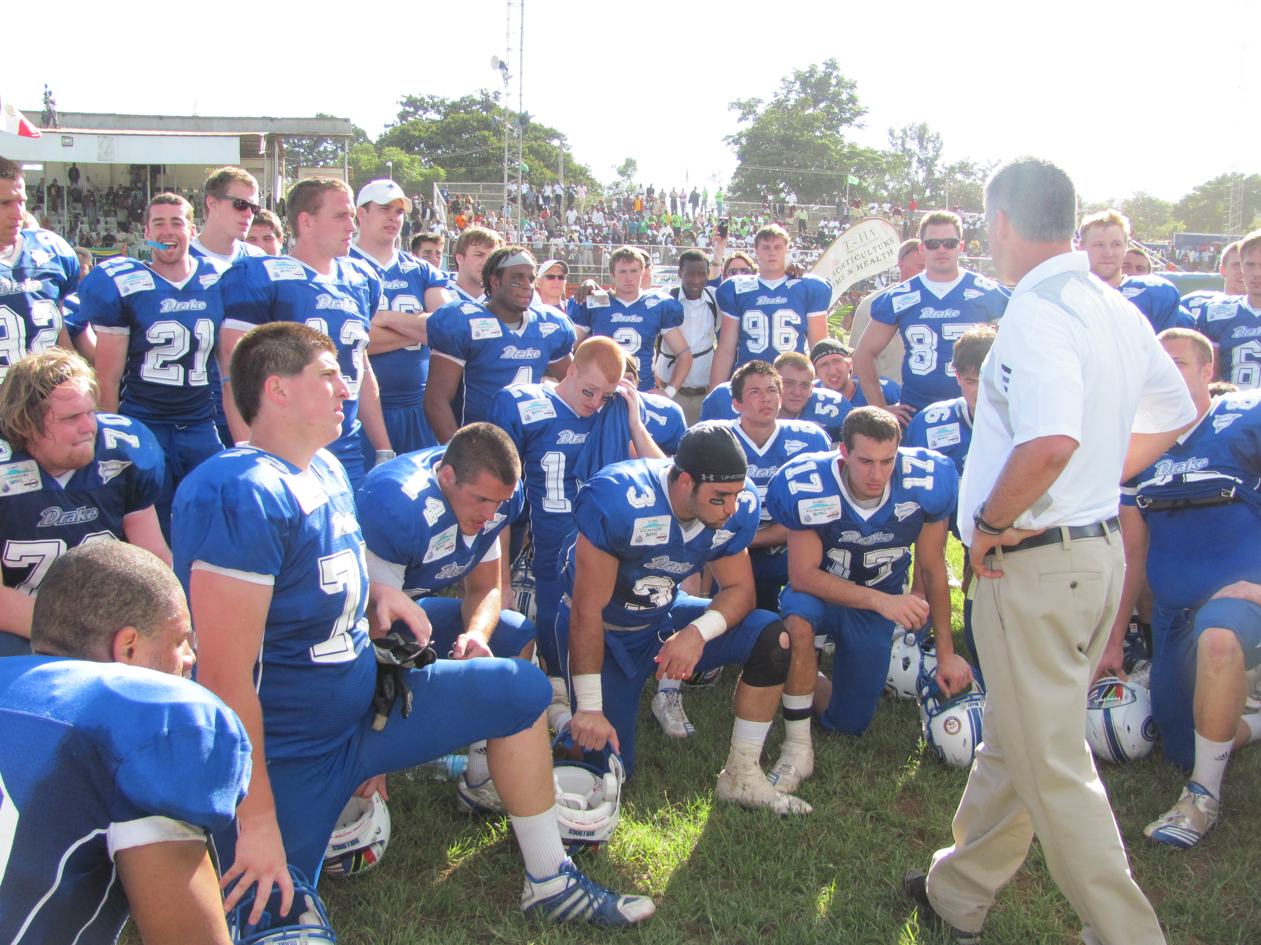
Gameday
Media were given sideline and grandstand access
More than 15 media outlets were represented and were introduced to the rules and basics of the game before kickoff
Broadcaster ITV Tanzania was serviced throughout the game
Presenters Mike Carlson and Reggie Brooks were provided with stats, rosters, injury updates, etc
Every key play was Tweeted and re-Tweeted by team PR throughout the game along with game atmosphere updates
Significant flip camera footage and media-quality photos were generated
Game recap was posted and hit the wire through AP within two hours of game finish
No media facilities available in-stadium

Slide 8
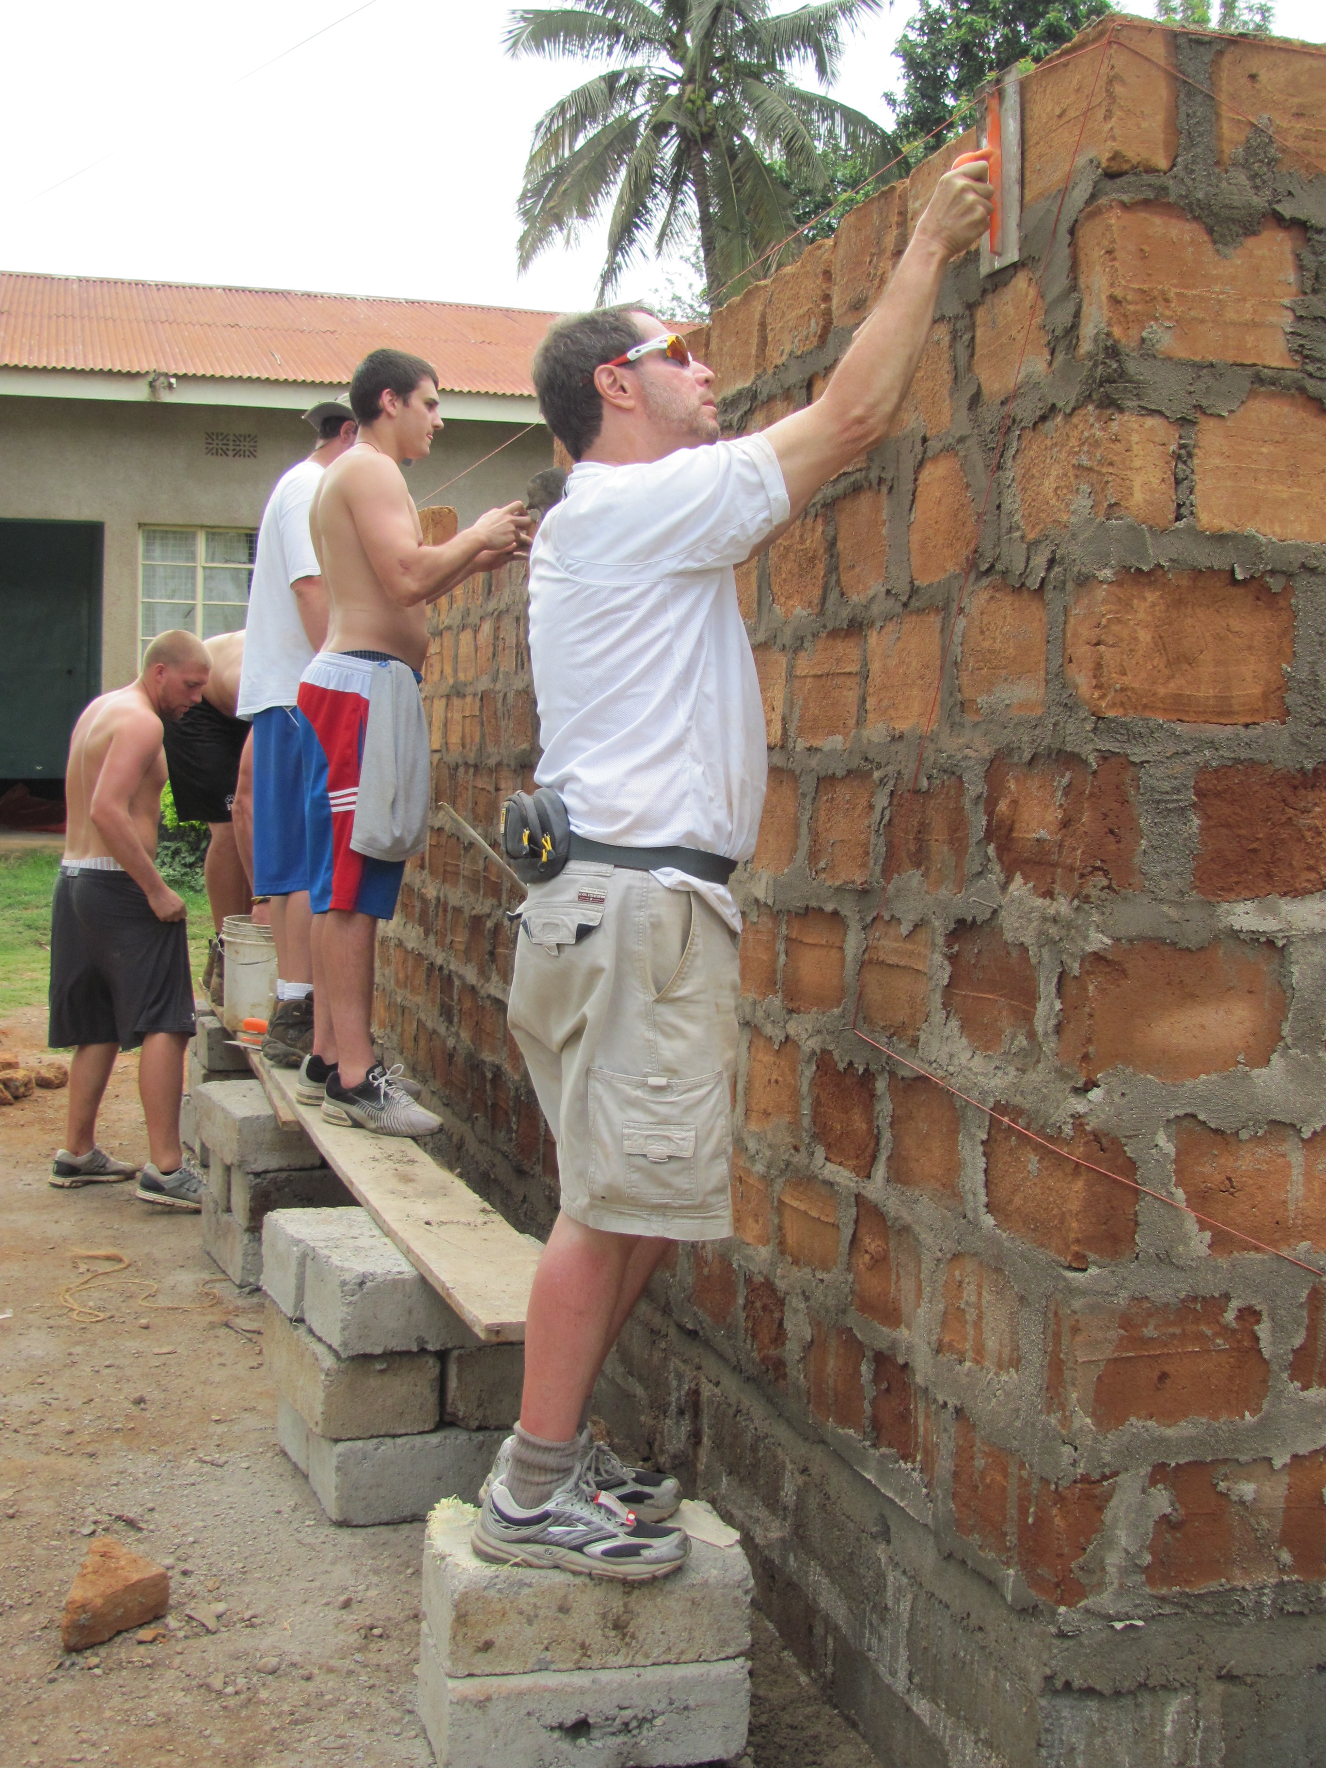
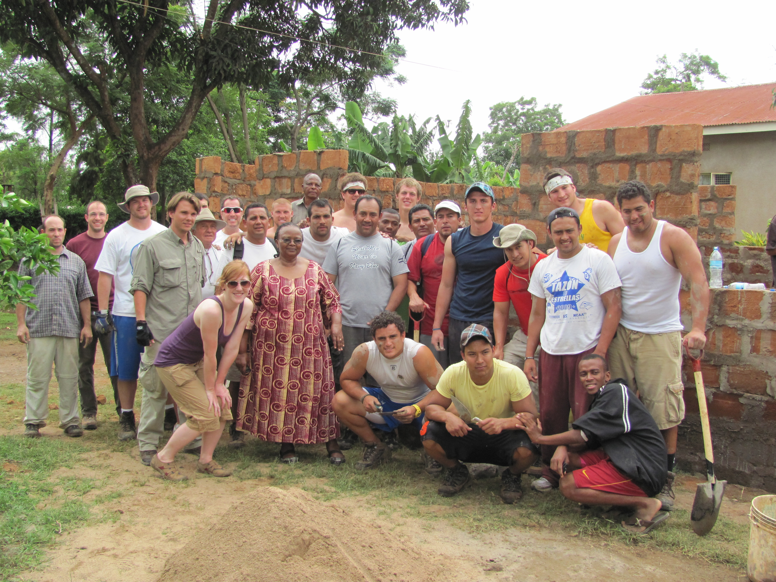
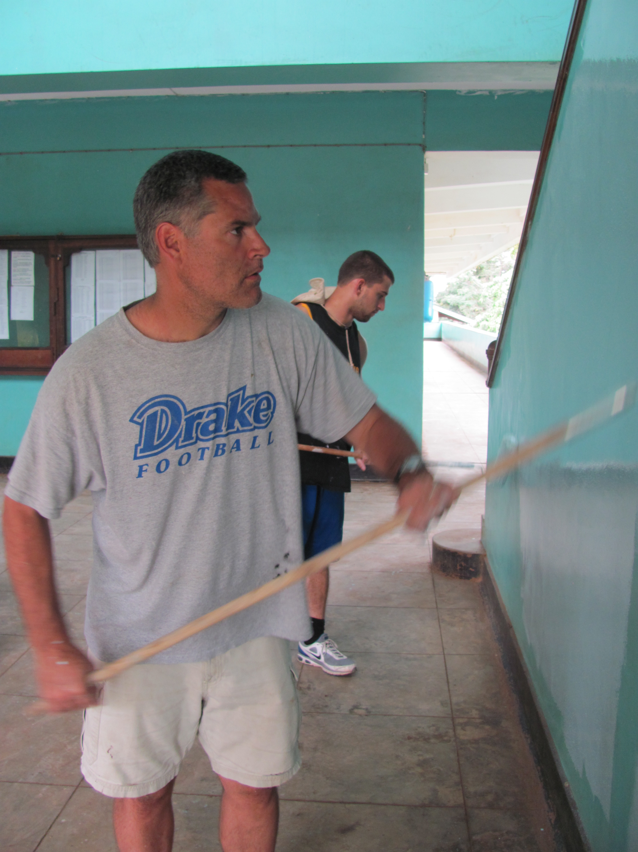
Service Projects
A concerted effort was made to underline the importance of the off-field activities in the community in addition to the prominent game story
Media were provided with notes, quotes and photos from the 11 service projects in Moshi
Drake University President Dr. David Maxwell and his sons actively participated
Strong presence created on social media
Participants in practice and game day interviews stressed the importance and impact of community projects
BBC World Service focused on the local interaction

Slide 9
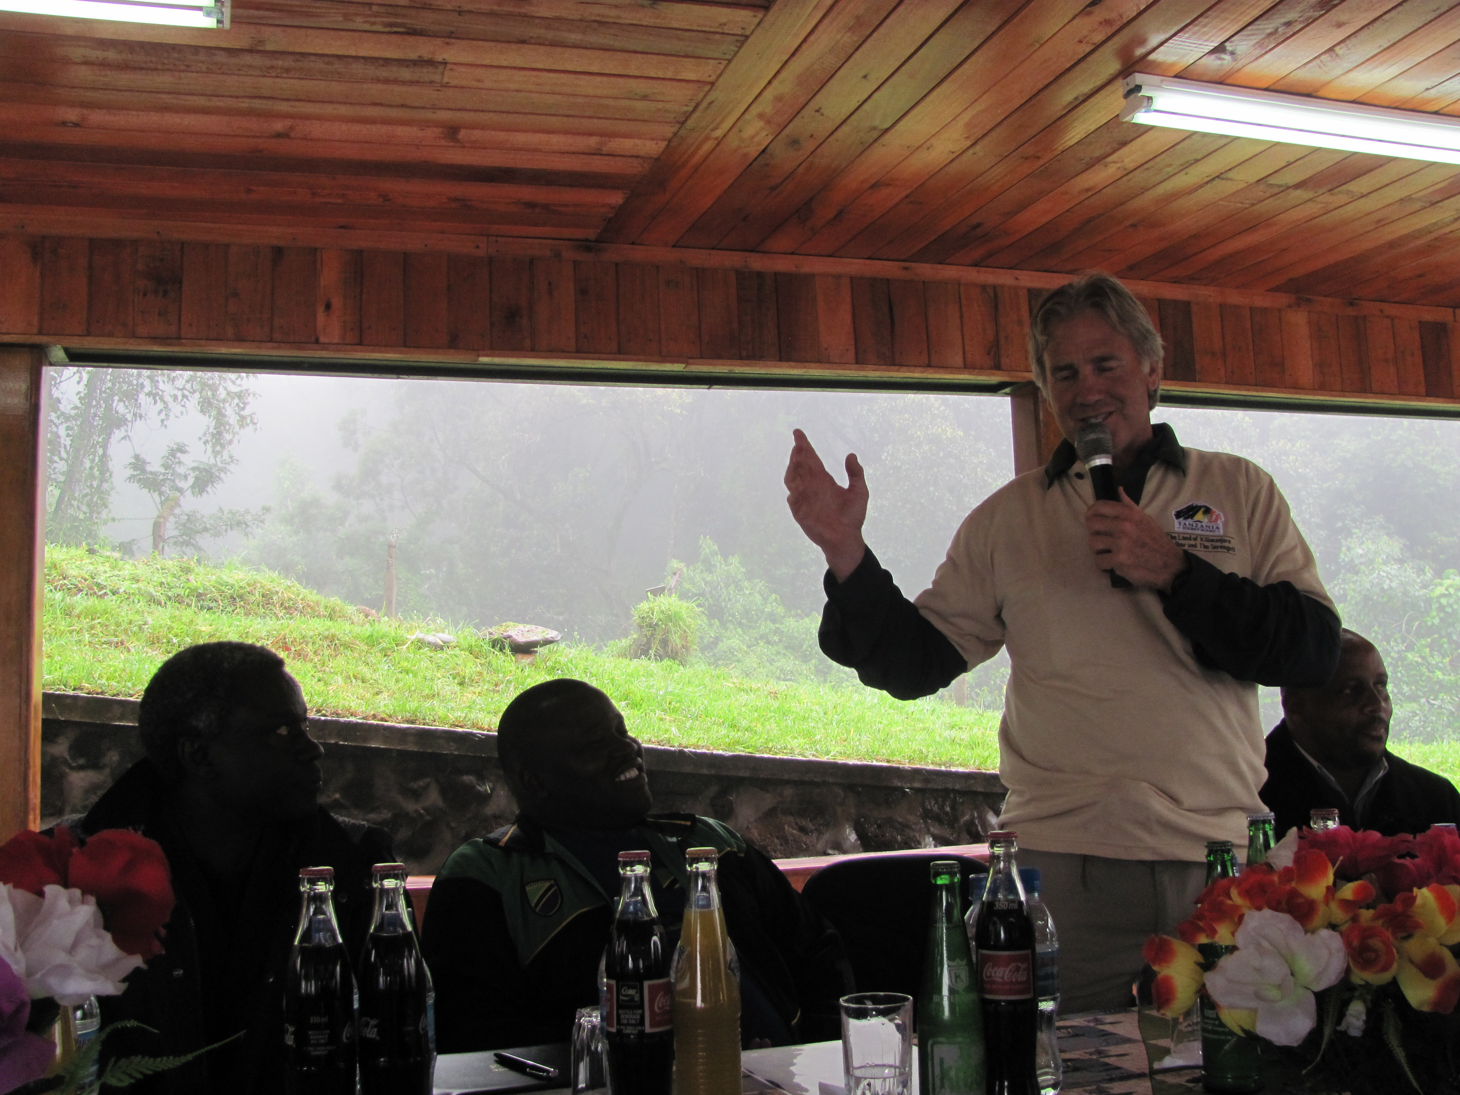
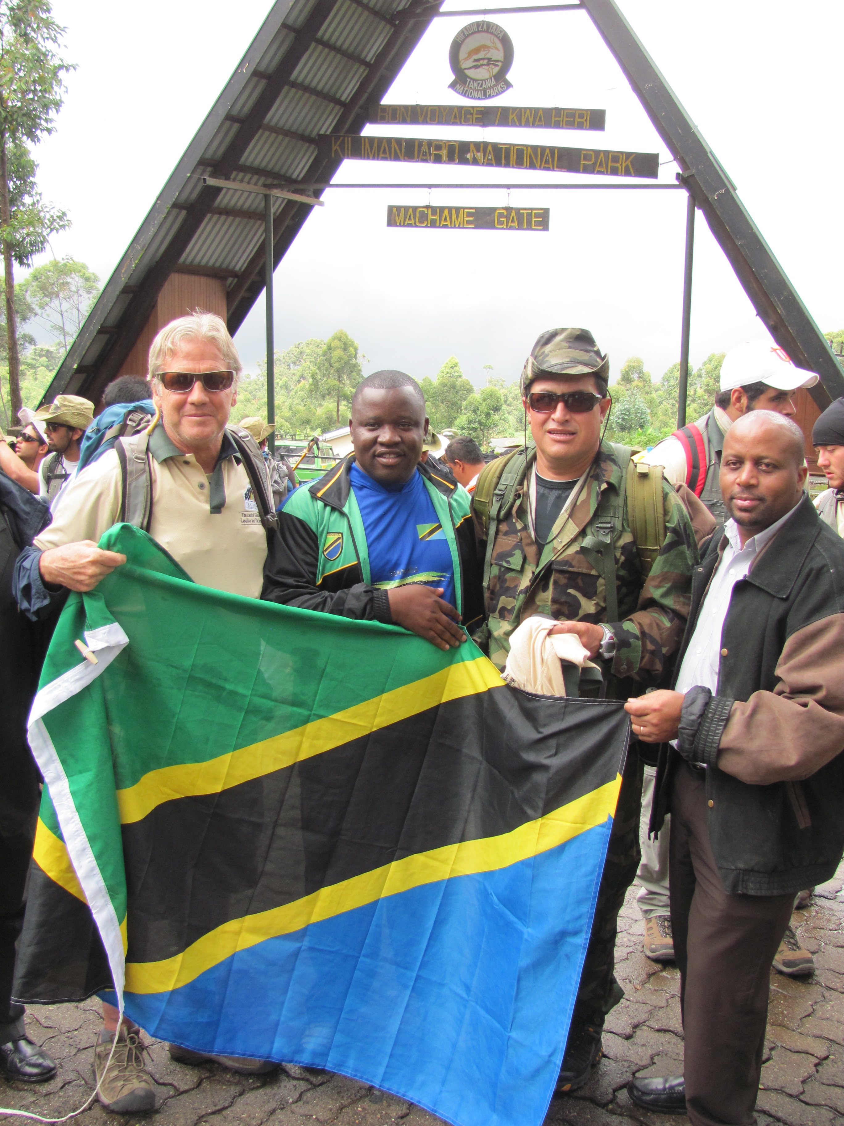
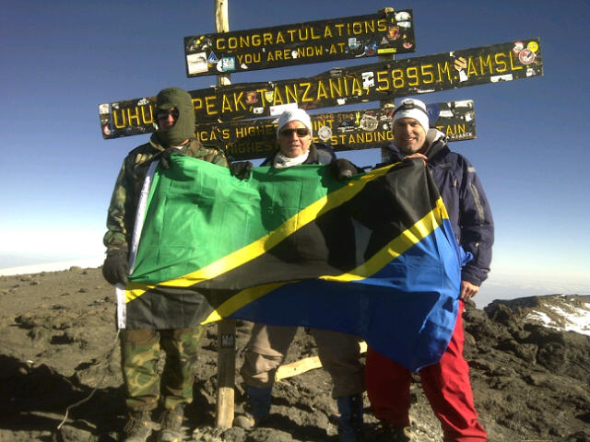
Mount Kilimanjaro Climb & Safari
The media contingent that had attended the practice facility press conference and game day were present at a press conference held before the Mexican group began their climb
Photos and news were posted immediately through social media outlets
Patrick Steengberge sent Tweets and provided updates throughout the climb that were conveyed to media
Blanket coverage provided by Tanzanian media following the start of the climb

Slide 10
Media attendance in Tanzania
More than 20 international media outlets attended Global Kilimanjaro Bowl events:
  Press conference at TGT practice facility
  Game at Arusha Stadium
  Beginning of Mexican group climb of Mt. Kilimanjaro
Media represented included:
  Tanzania: Arusha Citizen, Guardian, Daily News, Hibari Leo, ITV, Star TV, Channel 10, Mwananchi, Majira, Nipashe, Arusha Times, Triple A FM radio
  Kenya: Beyond Pictures documentary crew
  Mexico: Martin Contreras: Sports RZZM, stringer for various print media and websites
  United Kingdom: BBC World Service, NFLUK.com, Independent

Slide 11
Media Coverage - Newspapers
Newspaper | Story | Circulation
USA Today | Drake to Africa | 2,120,357
USA Today | Drake going distance | 2,120,357
USA Today | Drake wins | 2,120,357
New York Times | Drake wins | 1,194,491
LA Times | Drake wins | 959,863
San Francisco Chronicle | Drake wins | 525,897
Chicago Daily Herald | Touchdown in Tanzania | 487,480
Chicago Sun Times | Raise money for Africa | 487,480
Chicago Tribune | Football players to make history | 487,480
Boston Globe | Drake to Africa | 478,735
Boston Globe | Drake wins | 478,735
San Diego Union-Tribune | Drake wins | 374,856
Cleveland Plain Dealer | Drake wins | 368,322
St. Petersburg Times | Drake wins | 352,777
Miami Herald | Drake wins | 327,105
St. Louis Post-Dispatch | Drake wins | 301,718
Sacramento Bee | Drake wins | 296,482

Slide 12
Media Coverage - Newspapers
San Jose Mercury News | Drake wins | 275,576
Kansas City Star | Drake wins | 266,264
Indianapolis Star | Drake goes Global | 251,601
Indianapolis Star | Drake brings football/hope | 251,601
Toronto Sun | American Football to Africa | 248,460
San Antonio Express-News | Drake wins | 228,733
Seattle Times | Drake wins | 219,941
St. Paul Pioneer Press | Drake wins | 201,583
Austin Statesman | Drake wins | 190,986
Palm Beach Post | Drake wins | 185,314
Seattle Post Intelligencer | Drake wins | 169,105
Fresno Bee | Drake wins | 162,628
Birmingham News | Drake wins | 154,538
Des Moines Register | Drake goes Global | 153,792
Des Moines Register | Opens doors for Tazania | 153,792
Des Moines Register | Drake Football: QB sharp | 153,792
Des Moines Register | Drake brings football/hope | 153,792
Des Moines Register | Drake embracks on journey | 153,792
Des Moines Register | First game in Africa - made history | 153,792
Marshtown Times-Republic | Drake spring game | 153,792
Tulsa World | Drake heads to Africa | 143,598
Grand Rapids Press | Nick Ens to play | 142,036
Dayton Daily News | Drake wins | 137,533
Salt Lake Tribune | Drake wins | 134,542

Slide 13
Media Coverage - Newspapers
News Tribune | Drake wins | 127,629
Sarasota Herald Tribune | Drake wins | 116,990
Lexington Herald-Leader | Drake wins | 111,168
Washington Times | Drake wins | 109,049
Albany Times Union | Drake wins | 101,210
Wisconsin State Journal | Drake wins | 88,245
El Paso Times | Drake wins | 77,158
The Lakeland Ledger | Drake wins | 73,645
South Bend Tribune | Reggis Brooks | 72,941
Macon Telegraph | Drake wins | 71,561
Staten Island Advance | Drake wins | 69,413
The Oakland Tribune | Drake wins | 67,308
Idaho Statesman | Drake wins | 64,526
Erie Times News | Drake wins | 63,982
El Porvenir | Mexico team to Africa | 60,000
El Porvenir | Kilibowl | 60,000
Gainesville Sun | Drake wins | 50,804
Sioux City Journal | Drake to Africa | 48,175
Cape Cod Times | Drake wins | 46,757
Philly BurbsThe Intelligencer | Drake wins | 44,595
Beaver County Times | Drake wins | 43,232
Tri-City Herald | Drake wins | 41,151
York Dispatch | Drake wins | 40,416
Journal & Courier | Drake wins | 38,000
Dubuque Telegraph Herald | Going to great lengths | 29,376
Centre Daily Times | Drake wins | 25,969
Midland Daily News | Drake wins | 24,067
Galveston Daily news | Drake wins | 24,025

Slide 14
Media Coverage - Newspapers
Greeley Tribune | Drake wins | 23,817
Lebanon Daily News | Drake wins | 21,347
Columbia Daily Tribune | Drake wins | 18,855
Norman Transcript | North grad to play in Africa | 13,750
Corvallis Gazette Times | Drake wins | 13,170
Greenwich Times | Drake wins | 12,421
Argus-Press | Drake wins | 11,386
Summit Daily News | Drake wins | 8,500
Casa Grande Dispatch | Drake to Africa | 8,285
Moore American | Whitaker to Africa | 7,500
Annapolis Capital | Game in Africa
Cedar Rapids Gazette | Drake wins
Citizen Daily | Tanzania to host game
Citizen Daily | Rare treat for Tanzania
Daily News (Tanzania) | Tanzania to host game
Daily News (Tanzania) | TTB embracing game
Drake Magazine | Drake to Africa
ESPN Magazine | Africa first organized game
Guardian Reporter | Teams gear up
Guardian Reporter | Arusha stuns officials
Guardian Reporter | Drake triumphs in Arusha
Times-Delphic | Spring practice for Africa
Times-Delphic | Reaching new heights
 | Total: | 19,853,498

Slide 15
Media Coverage - Internet
Media Outlet | Story
ESPN.com | Drake to Africa
FoxSports | Bill LeMonnier
AllAfrica.com | Football in Africa
Safari Getaway | Football in Africa
Notre Dame 247Sports | Reggie Brooks
National Football Foundation | Tanzania to host first game
Pro Football Examiiner | Kilibowl
Pro Football Examiiner | Kilibowl Part 2
ESPN.com | Extreme Road Trip
Global Travel Industry news | American Football set in Tanzania
AllAfrica.com | First ever game in Africa
Forbes | Drake wins 1st game
SI.com | Drake wins 1st game
Rueters Africa | American Football to Africa
HuskerExtra | Drake wins 1st game
Tackleo.com | Kilibowl

Slide 16
Media Coverage - Internet
Yahoo Mexico | Kilibowl
Yahoo Sports | Kili bowl brings Football to Africa
MSNBC.com | Kili bowl brings Football to Africa
ABC News | Drake wins 1st game
CNS News | Drake wins 1st game
FOX news | Drake wins 1st game
Business Insider | Drake wins 1st game
Sporting News | Drake wins 1st game
NPR | Drake wins 1st game
CSN Baltimore | Drake wins 1st game
Mail.com | Drake wins 1st game
Central Oregon.com | Drake wins 1st game
Rivals Yahoo | Drake wins 1st game
Yahoo - UK & Ireland | Kili bowl brings Football to Africa
Sport & Dev UT.edu | Kili bowl brings together 1,000 young people Flying High In Tanzania

Slide 17
Media Coverage – TV & Radio
Media | Story
ESPN Sportscenter BBC World Service ESPN First Take ESPN Deportes 9News – Colorado | Game highlights including Drake TD Mike Carlson Reports Extreme Road Trio Game highlights including CONADEIP TD drive Drake competing
WBUR | Africa - ready for football
WSBT | Reggie Brooks
Action3 News | Drake to Africa
WGRZ | Drake to Africa
News10 | Drake to Africa
11 Alive | Drake to Africa
WTSP | Drake to Africa
WKYC | Drake to Africa
KSDK | Drake to Africa
Iowa Public Radio | Kilibowl
WZZM | Drake to Africa
NFL UK | Inside the Huddle Podcast
NFL UK | Inside the Huddle Podcast
CBS 8 | Drake wins
KCRG-TV | Drake wins

Slide 18
Media Coverage – TV & Radio
KGWN-TV WREX WKRN | Drake wins Drake wins Drake wins
WMCTV | Drake wins
WSFA | Drake wins
KTVN | Drake wins
KGMB-TV | Drake wins
WVIR-TV | Drake wins
WQOW | Drake wins
WVVA-TV | Drake wins
WECT-TV | Drake wins
WBOC | Drake wins
WLBT | Drake wins
WISTV | Drake wins
WROL Orlando | Drake wins
1590 KLFE | Drake wins
NTV | Drake wins
WTHR | Drake wins
KCBD | Drake wins
WLOX | Drake wins
WRAL | Drake wins
FOX 41 | Drake wins
KTTC | Drake wins

Slide 19

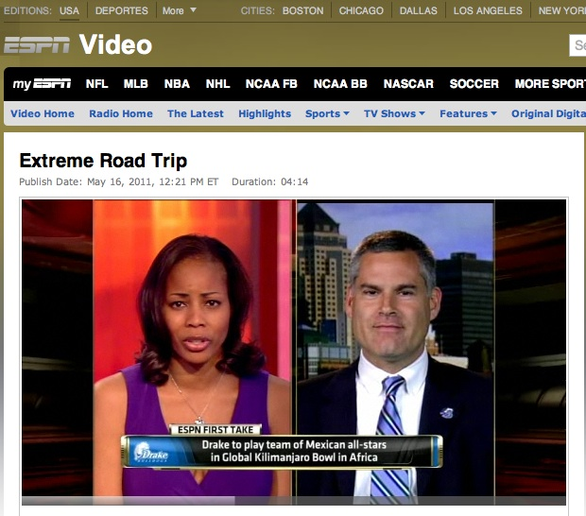
Media Coverage TV sample: ESPN First Take

Slide 20
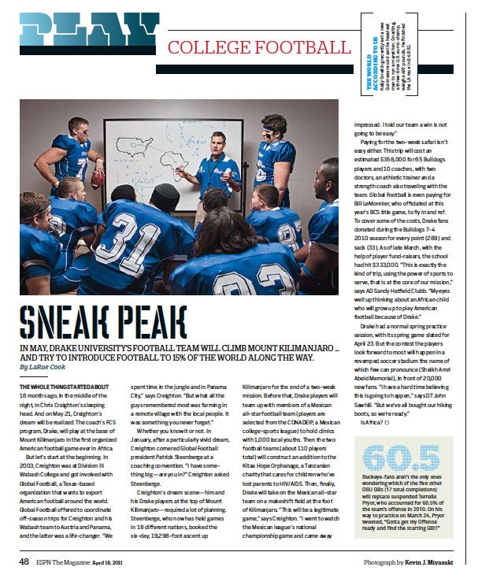
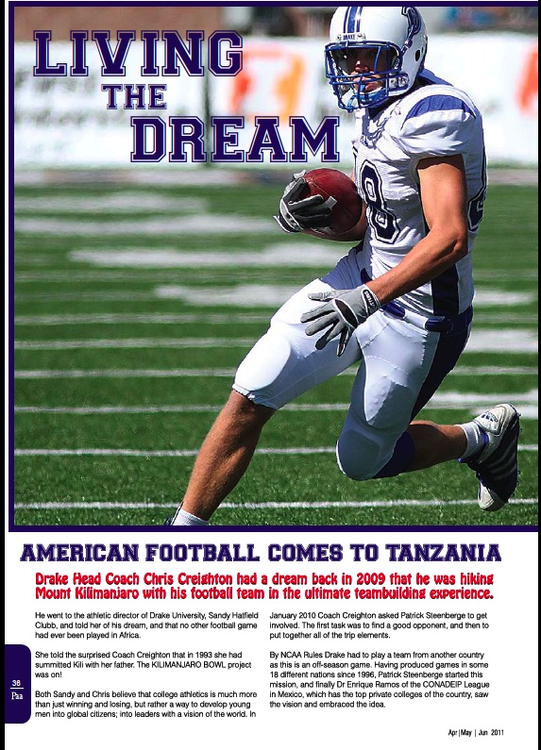
Media Coverage print samples

Slide 21
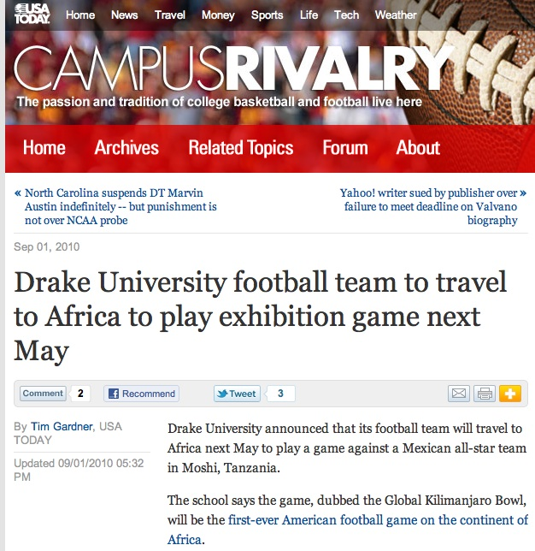

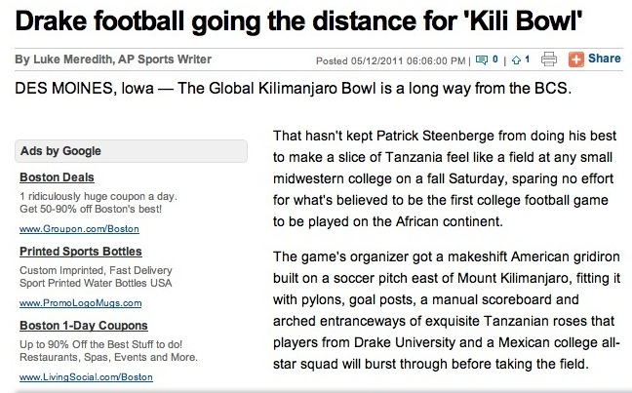
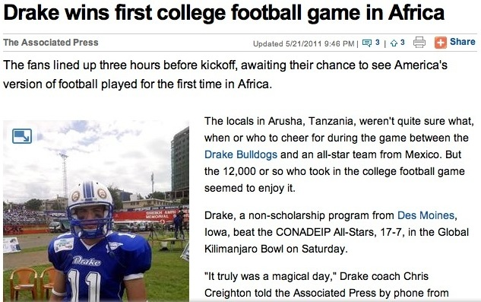

Media Coverage print samples

Slide 22
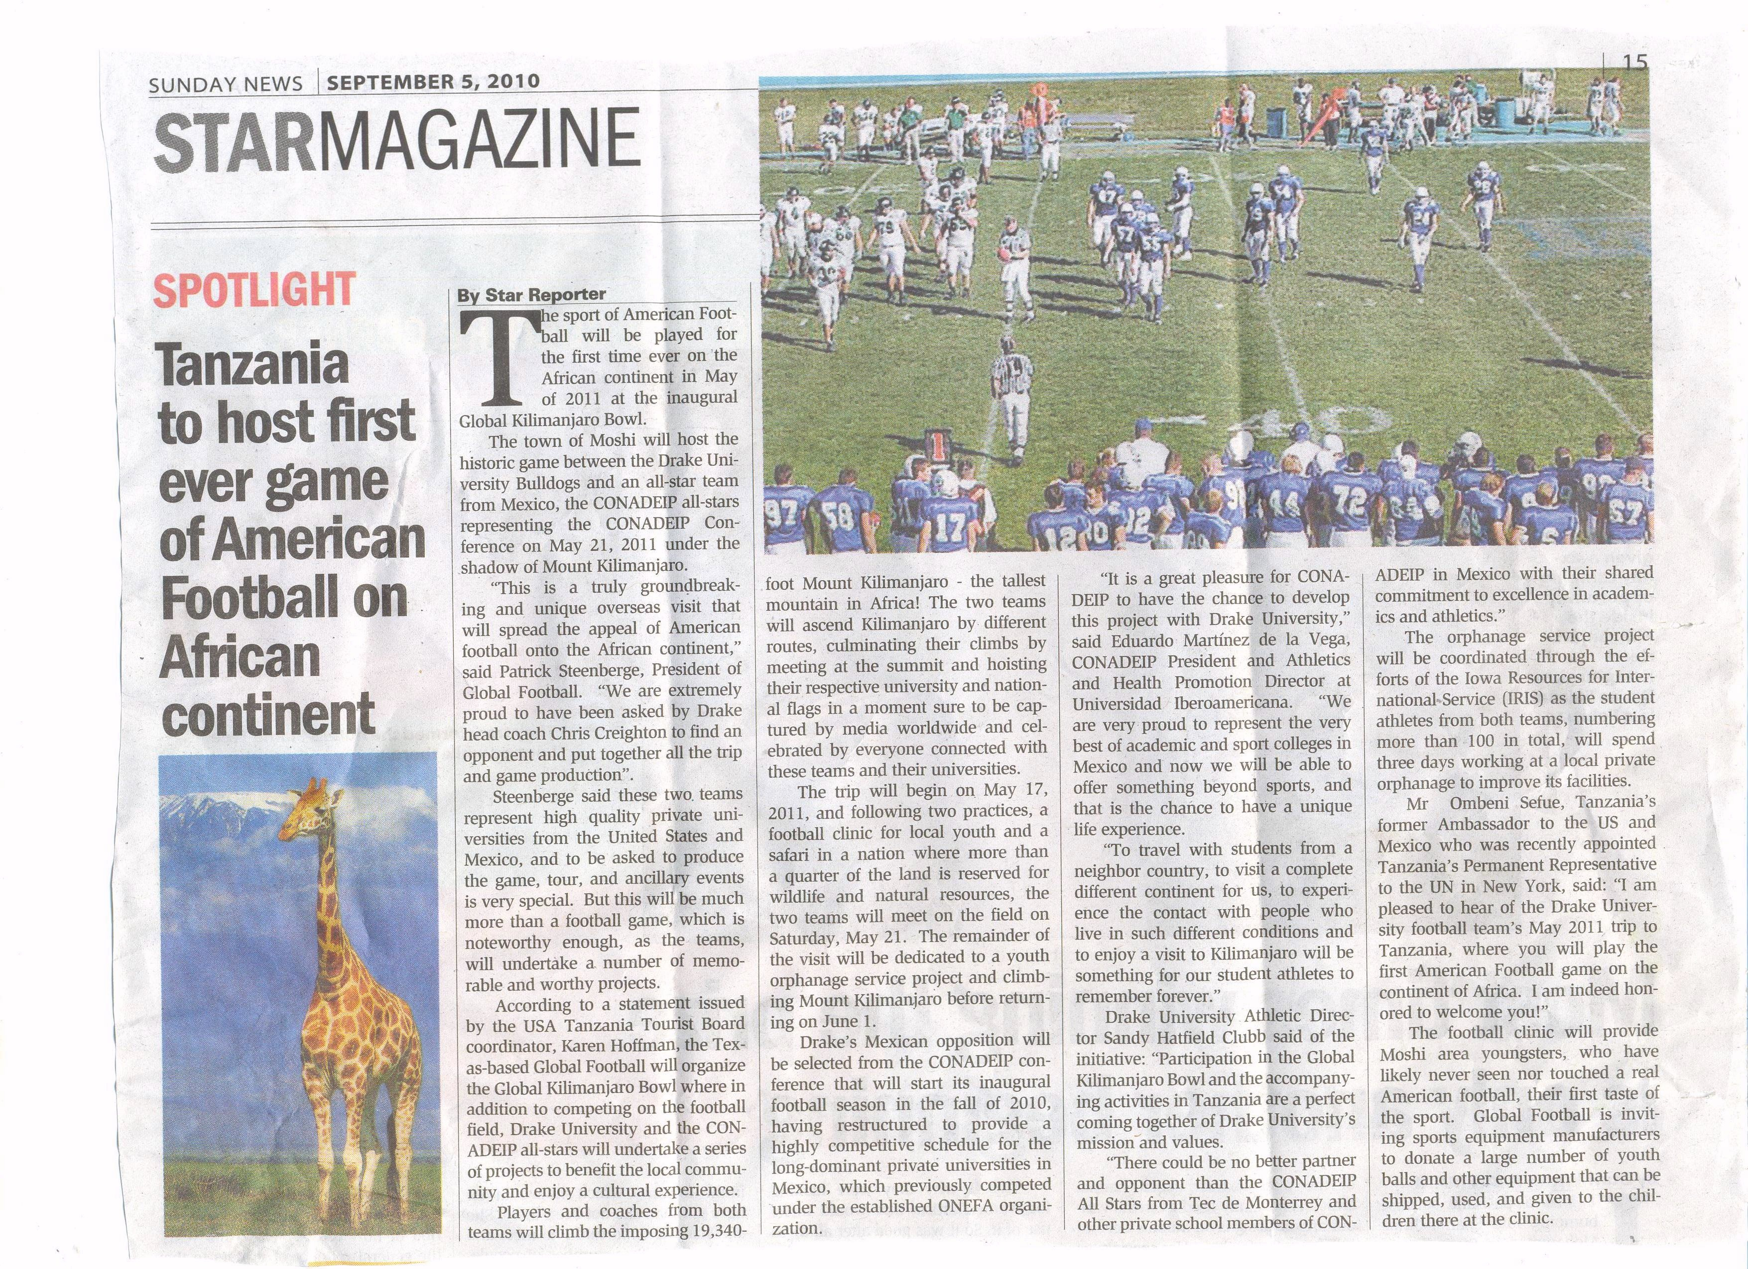
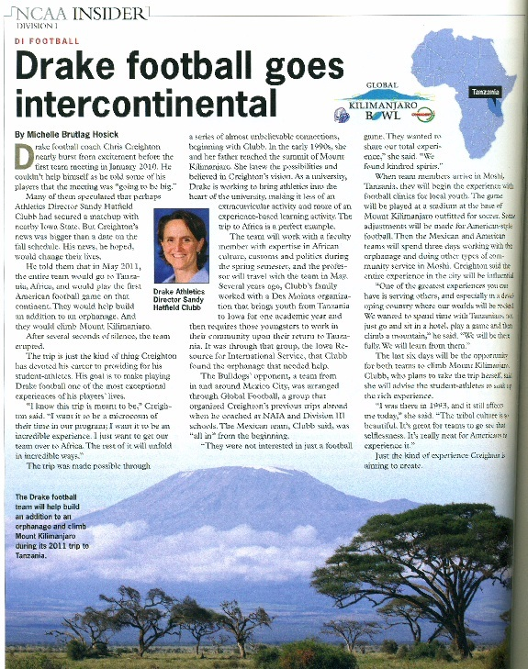
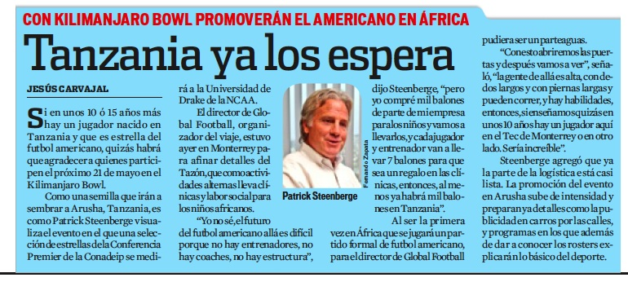
Media Coverage Tanzanian samples

Slide 23
Press Releases
Since the point of first announcing the Global Kilimanjaro Bowl on Sept 1, 2010 to the period following the event, a total of 34 press releases were created and pitched to media
Event announcement
Younger Optics sponsorship
Anthony Travel tours
Patrick visit to Tanzania
Second Tanzania visit
Venue switch to Arusha
Photos available to view from visit
Head game official announced
Donate to well project
Kili Bowl ITV broadcast
Teams to host a football clinic
Reggie Brooks to participate
International officials
Broadcast talent confirmed
Drake & CONADEIP spring practices
Arusha Hotel partners with Kili Bowl
Younger Optics sponsor reminder
Press conference information
Social media plans for Kili Bowl
Staff head to Tanzania
General notes & quotes
Teams arrive in Tanzania
TANAPA sponsorship
Team practices and football clinics
Service projects, Stemm
Teams benefit Moshi schools
Group reaches Kilimanjaro summit
Event VIPs
Event safaris
Ground operations

Slide 24
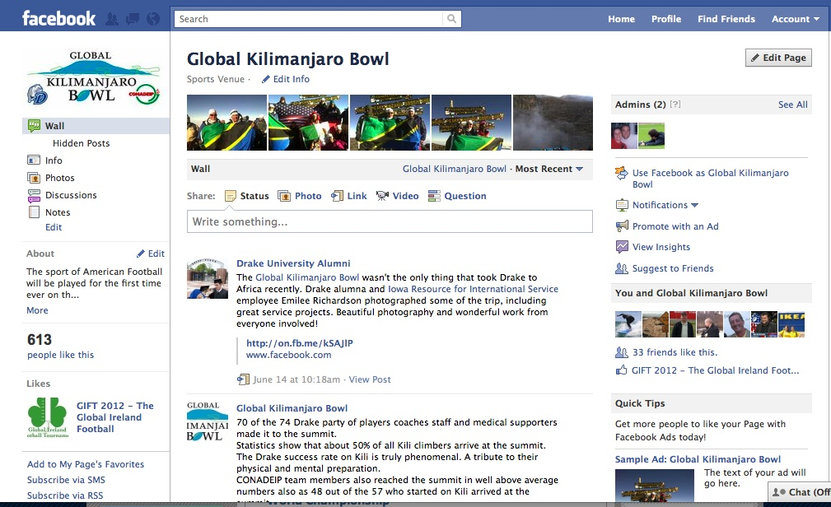
Social Media
Regular updates were posted throughout the event to the Global Kilimanjaro Bowl Facebook page and pages were integrated with the event Twitter site, Drake and CONADEIP Facebook pages, etc

Slide 25
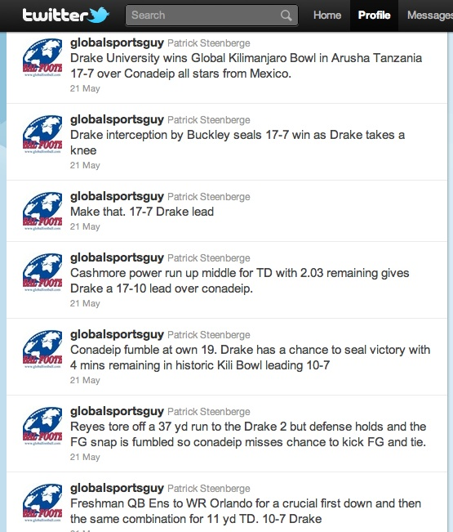
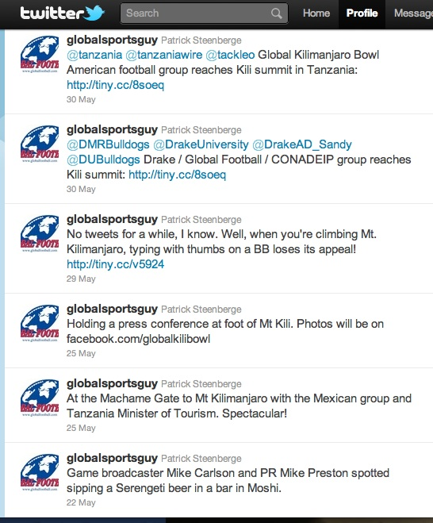
Social Media
Twitter provided the ideal platform from which to report back plays, updates and scores on game day in the absence of an in-stadium internet connection
Tweets were re-Tweeted by Drake and CONADEIP PR staff and by media

Slide 26


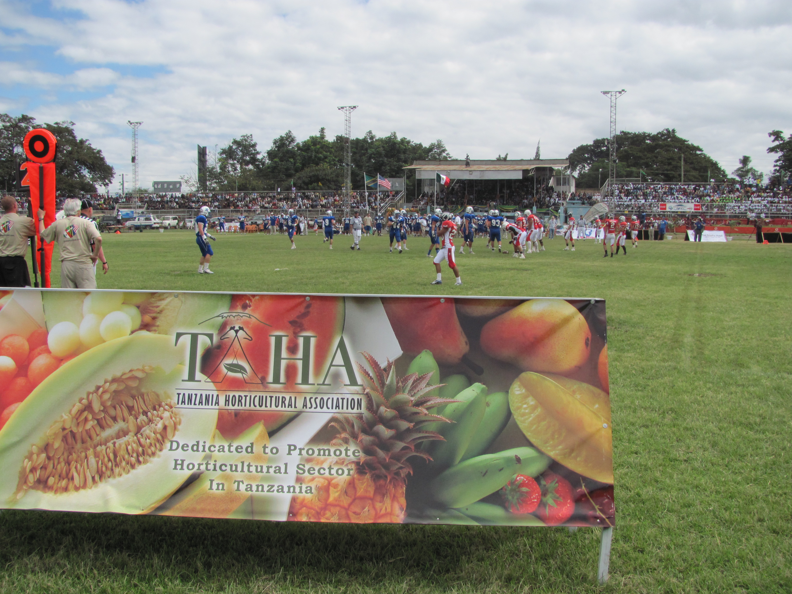
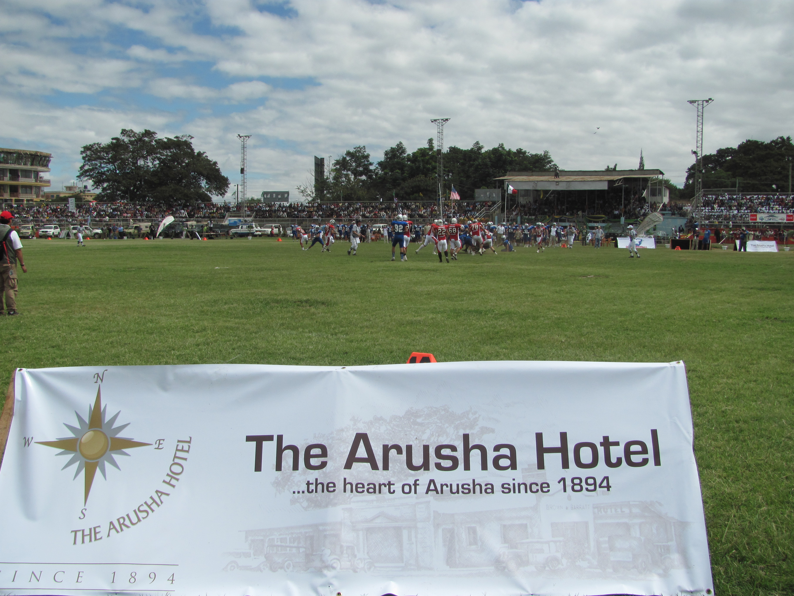
Sponsors
Sponsors and partners were integrated into all elements of the public relations strategy for the Global Kilimanjaro Bowl to ensure maximum exposure whenever possible
Strategic brand placement at events, practices and on game day
Sponsors were included in all press releases and media pitches
Key sponsors TANAPA, TAHA, TZ Tourist Board, The Arusha Hotel and Younger Optics were featured in standalone press releases
Partners including the TGT facility, Nitoke Safaris and Kilele Savane were all highlighted
The Global Football, Drake University and CONADEIP brands were all prominent

Slide 27

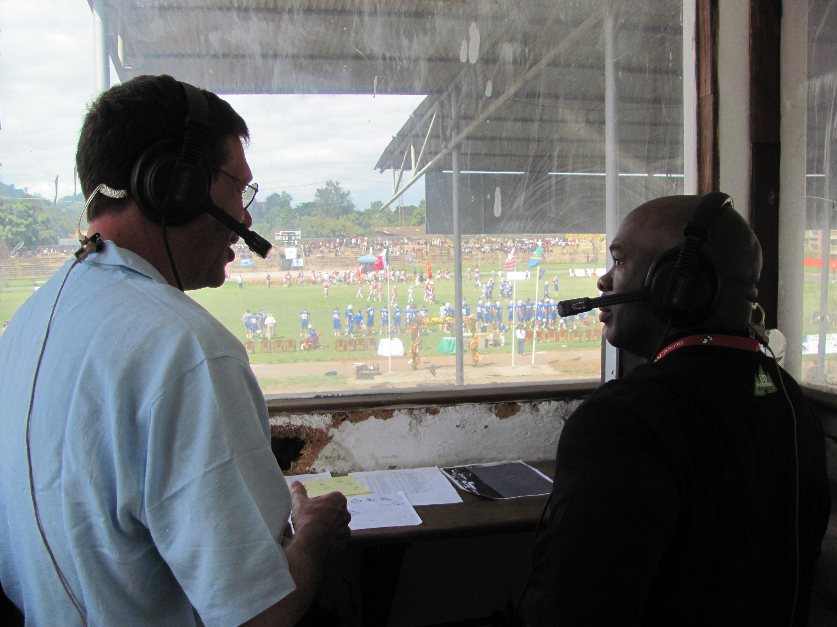
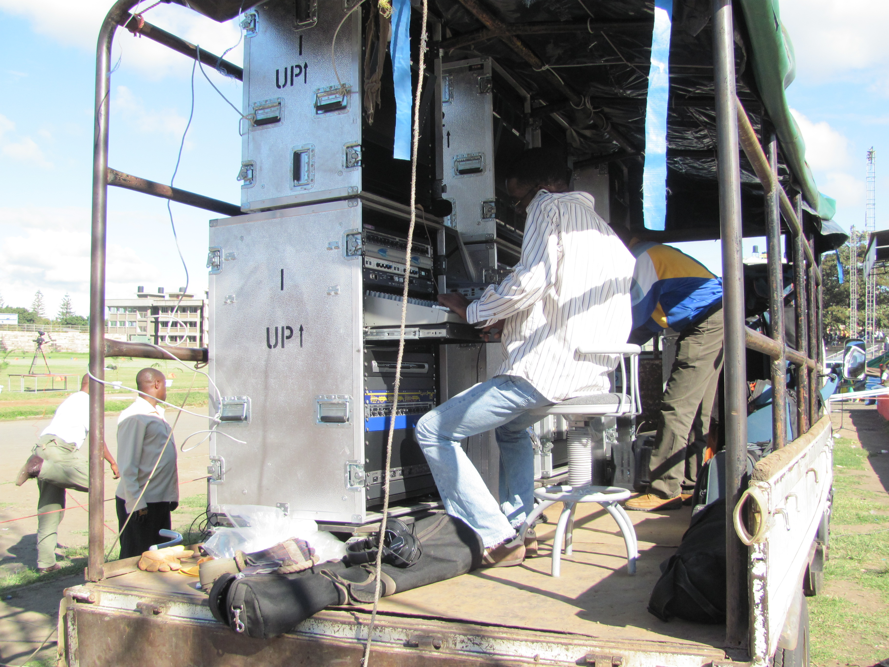
TV Broadcast
Preston Consulting identified Mike Carlson as the ideal game presenter to work with ITV due to his background of having helped introduce the sport to the UK TV audience
An agreement was negotiated for Mike Carlson to participate in the event and also generate additional media coverage
Media services were provided to the broadcaster ITV throughout the build up to the Kili Bowl and during the event
Footage was distributed that subsequently ran on ESPN Sportscenter, ESPN Deportes and three Des Moines TV stations local to Drake
The broadcast talent pairing of Mike Carlson and Reggie Brooks were provided with information including rosters, injury updates and stats throughout the game

Slide 28
Testimonials
“Reading all the media clips, I am so moved you cannot imagine. Totally awesome. We hope that this will be ’to be continued’. You made this happen, as did the players… Hongera! And Michael, the coverage...wow!”
- Karen Hoffman, President, Bradford Global Marketing, Tanzania
“I would like to extend our gratefulness to you and the entire Global Football Team, Drake University, the Mexico team and everyone who allowed us to participate and gain access to film and experience history during the Global Kili Bowl last weekend. We will forever be grateful.”
- Lukas Mwanzia, Beyond Pictures Ltd, Kenya
“Outstanding! Thanks again for all of your hard work. The beauty of this trip (as you captured perfectly) is all the people who unselfishly came together to do something special and much bigger than themselves. This is fantastic. I am far from over this trip.”
- Chris Creighton, Head Football Coach, Drake University

Slide 29
Future Recommendations
Pitch event to NFL Network, encouraging them to send a NFL Films crew to shoot footage
Explore a means to provide satellite footage, radio broadcast and webcast
Increase national media commitments
Ensure the likes of SI or ESPN Magazine send a reporter to cover events
Partner with NFL or prominent player / coach to travel and serve as an honorary representative and assist with coaching clinics
Implement a revised social media strategy to better penetrate the followers of the participating teams
Integrate International Federation of American Football (IFAF) to open the event to a wider football audience
Source an event-specific photographer available for the duration

Slide 30
Preston Consulting
For more than a decade Preston Consulting has promoted events in the international sporting arena on five continents for clients including the National Football League, Global Football, USA Football, IFAF, Major League Soccer, Fathead, Soccer United Marketing, Arena Football and the United Football League
Michael Preston
Preston Consulting
661 Washington Street
Suite 310
Norwood, MA
02062
USA
781-363-0305

