Slide 1


Slide 2
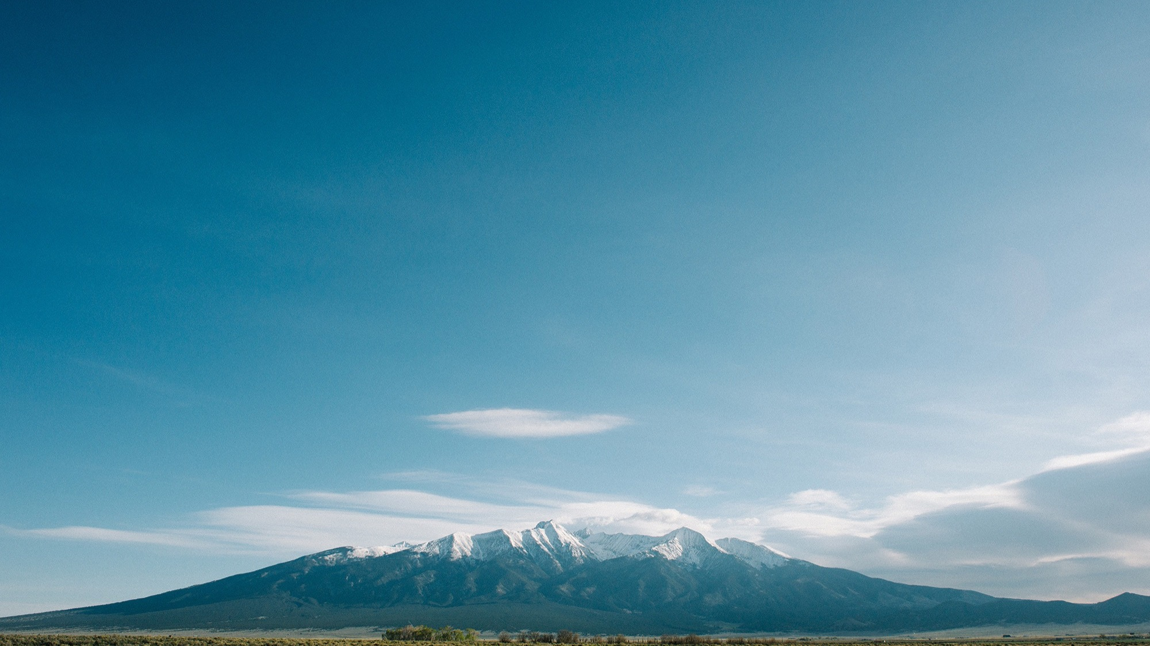


Presented by
Global Football & Dvorak Expeditions
Dvorak's Rafting & Fishing Expeditions
Est. 1969

Slide 3
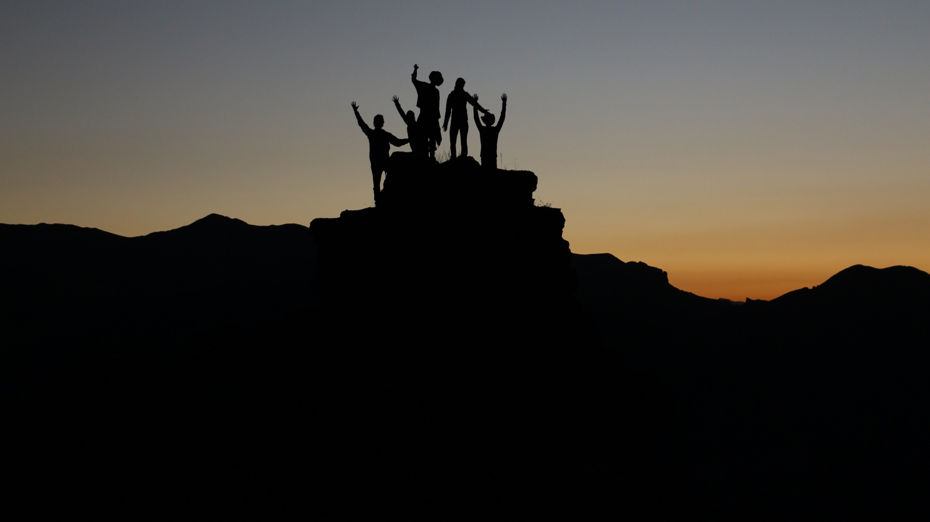
KILELENI-
Swahili word meaning ‘to the Summit’
Each Day, Each Task, Every Moment

Slide 4
Provide athletic Teams with a unique opportunity to utilize the challenging natural environment of the Colorado Rockies in ways that will:
Develop Team leaders
Build powerful personal relationships among Team members
Demand the athletes sacrifice for the success of the Team
Enable Team leaders to emerge
Focus on Mental Strength of each individual, and the TEAM
Allow the Team to celebrate the accomplishments achieved together
Through intense Effort, selfless Leadership and powerful Peer Support, each Team member will approach their PERSONAL BEST , and help the TEAM do same.

Slide 5
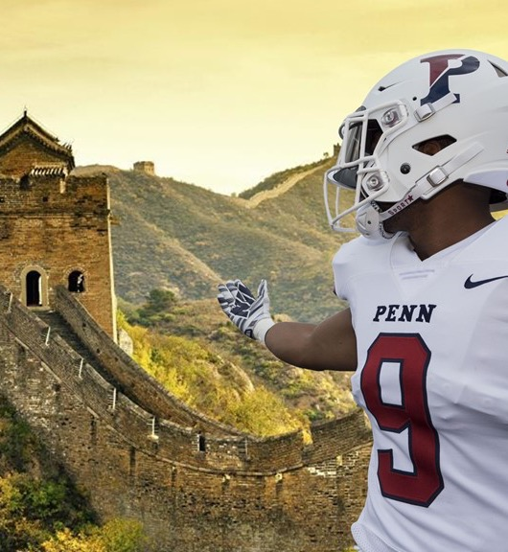
Praise For The Global Football Team
“Patrick, China 2019 was an unbelievable trip, and you and your team were tremendous. The best with whom I’ve had the opportunity to work on a trip.”
- Dr. M. Grace Calhoun
Director of Athletics and Recreation
University of Pennsylvania
Chair of NCAA Division I Council

Slide 6

The Team, especially those with powerful, motivated Leaders,
has the unique ability to support each individual member
mentally and physically, to allow that Team member to
perform and achieve seemingly impossible tasks,
thereby helping the Team achieve its stated goals.
A well-trained and properly motivated Team,
with strong Leadership, will achieve their Mountaintop…
Then transfer the lessons learned to their athletic competition,
to their personal lives.

Slide 7
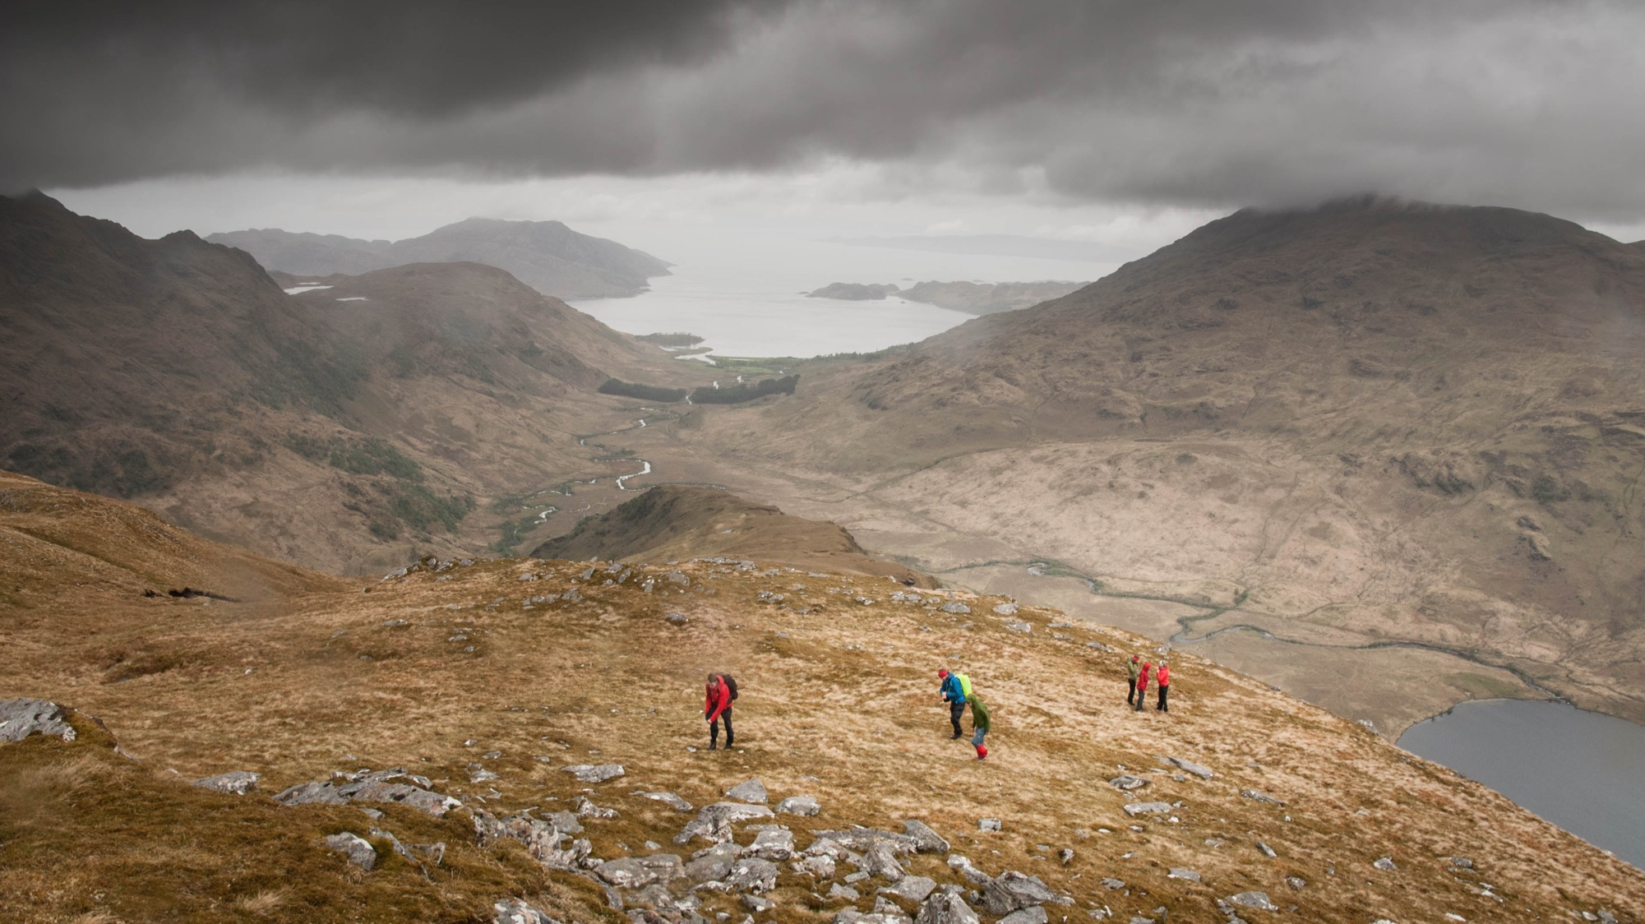
INSTILL LEADERSHIP IN YOUR TEAM

Slide 8
Seeking Leaders wanting to develop their talents to enable Peak Performance, thereby helping build their team!
Amateur athletic Teams- mens and womens, all sports, all ages
Football, Soccer
Swimming, lacrosse, volleyball
Basketball, softball, baseball
Hockey, track & field, field hockey, etc.

Slide 9
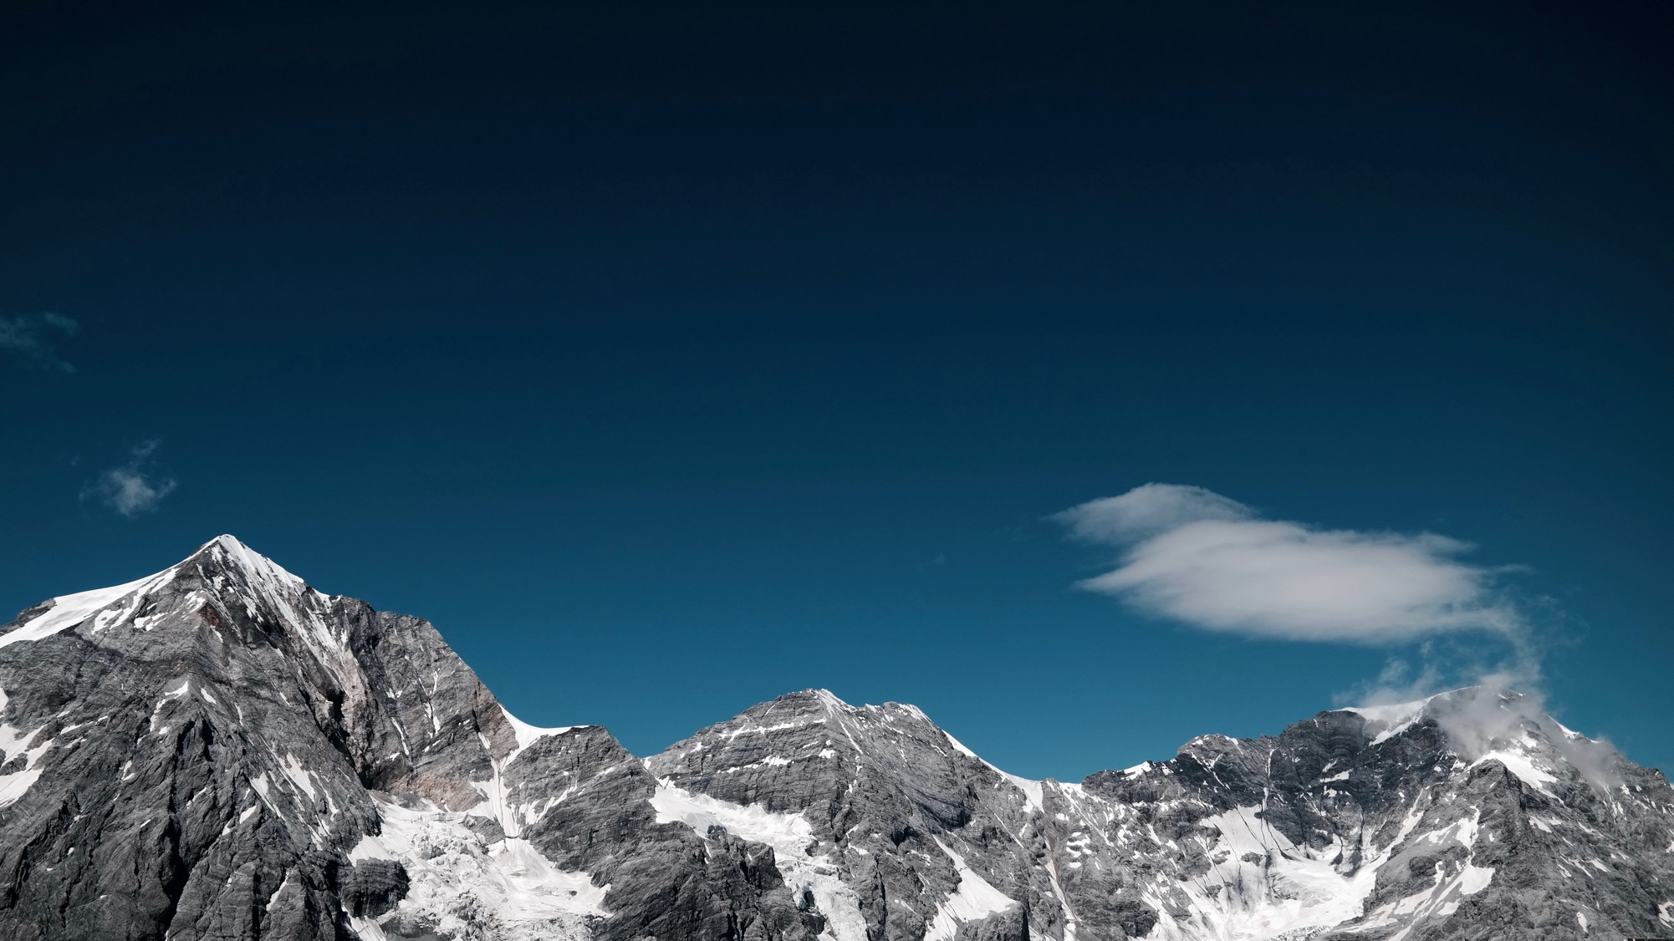
METHODS TO ACHIEVE THE MOUNTAINTOP

Slide 10
Based upon decades of experience in athletics, travel, communications
and business, we know that Teams can be uniquely forged outdoors,
and lessons transferred to other goals the Team may use in its sport.
The single-most powerful challenge in nature that a Team can face and overcome,
together, in the space of one day is to hike to the summit of a rugged mountain.
There are over 600 mountains in Colorado that tower more than 13,000 feet, 58 of them over 14,000 feet, hundreds more somewhat lower yet each presenting a uniquely daunting challenge.
Each poses dramatic physical barriers, as well as mental and emotional ones, very similar to real-life obstacles needed to overcome in order to achieve success.
Teamwork and Leadership are best learned through Experience, Outdoors!

Slide 11
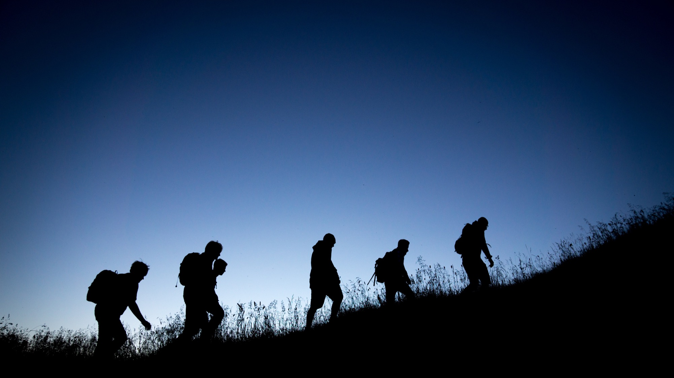
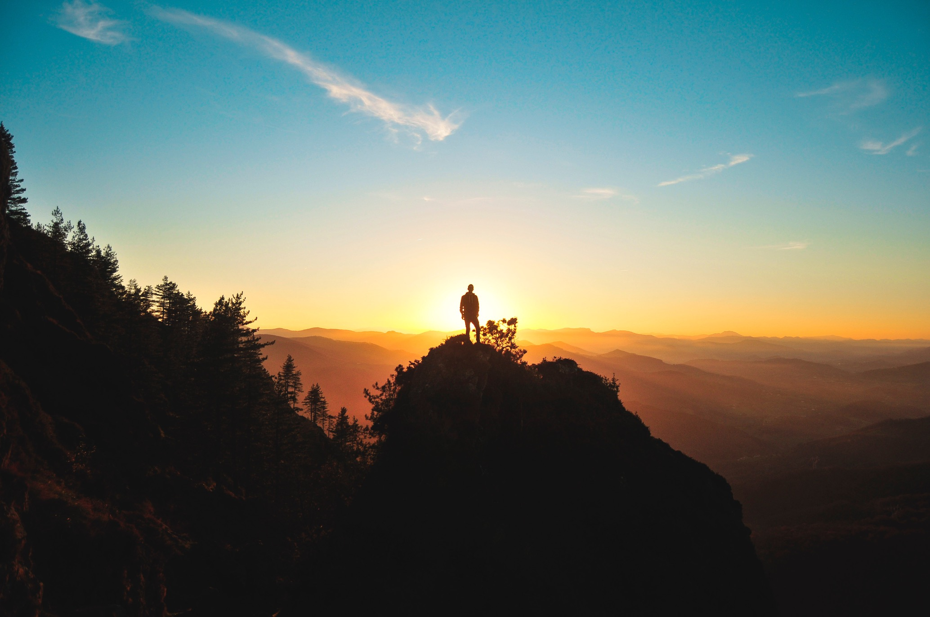
IDENTIFY THE LEADER WITHIN

Slide 12
Our ‘Kileleni Leadership’ group understands, through decades of experience, the key elements encountered during these Outdoor Learning Adventures.
These obstacles will cause novice hikers to seek out Leaders among their peers, to bond together in physical and mental spirit in order to get every Team member to the mountaintop, to Summit as a TEAM.
Our pre and post-hike ‘huddles’ are critical, as will focus on key topics the Coach feels are important for his or her student athletes, in conjunction with items we as leaders and instructors also feel are impactful.

Slide 13
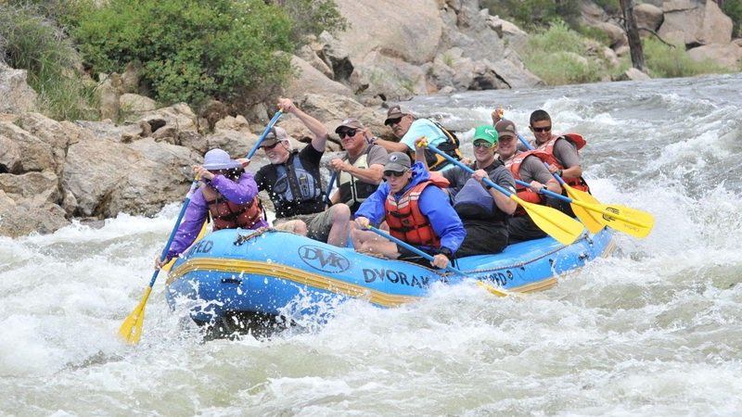
TEAM EXPERIENCES

Slide 14
We suggest including two other challenging outdoor TEAM elements, providing a comprehensive 2 or 3-day experiences.
Taking on one of America’s top whitewater rivers, the Arkansas, working together in 4-6 person boat teams, coordinated and led by a highly skilled and experienced river guide.
Whitewater rafting requires each team member to closely adhere to instructions, to paddle as directed, to achieve success by getting safely downstream and to overcome normal individual fears.
4-6 hours daily on a frothing, dynamic river paddling together will work wonders in developing your Team, in identifying Leaders.

Slide 15
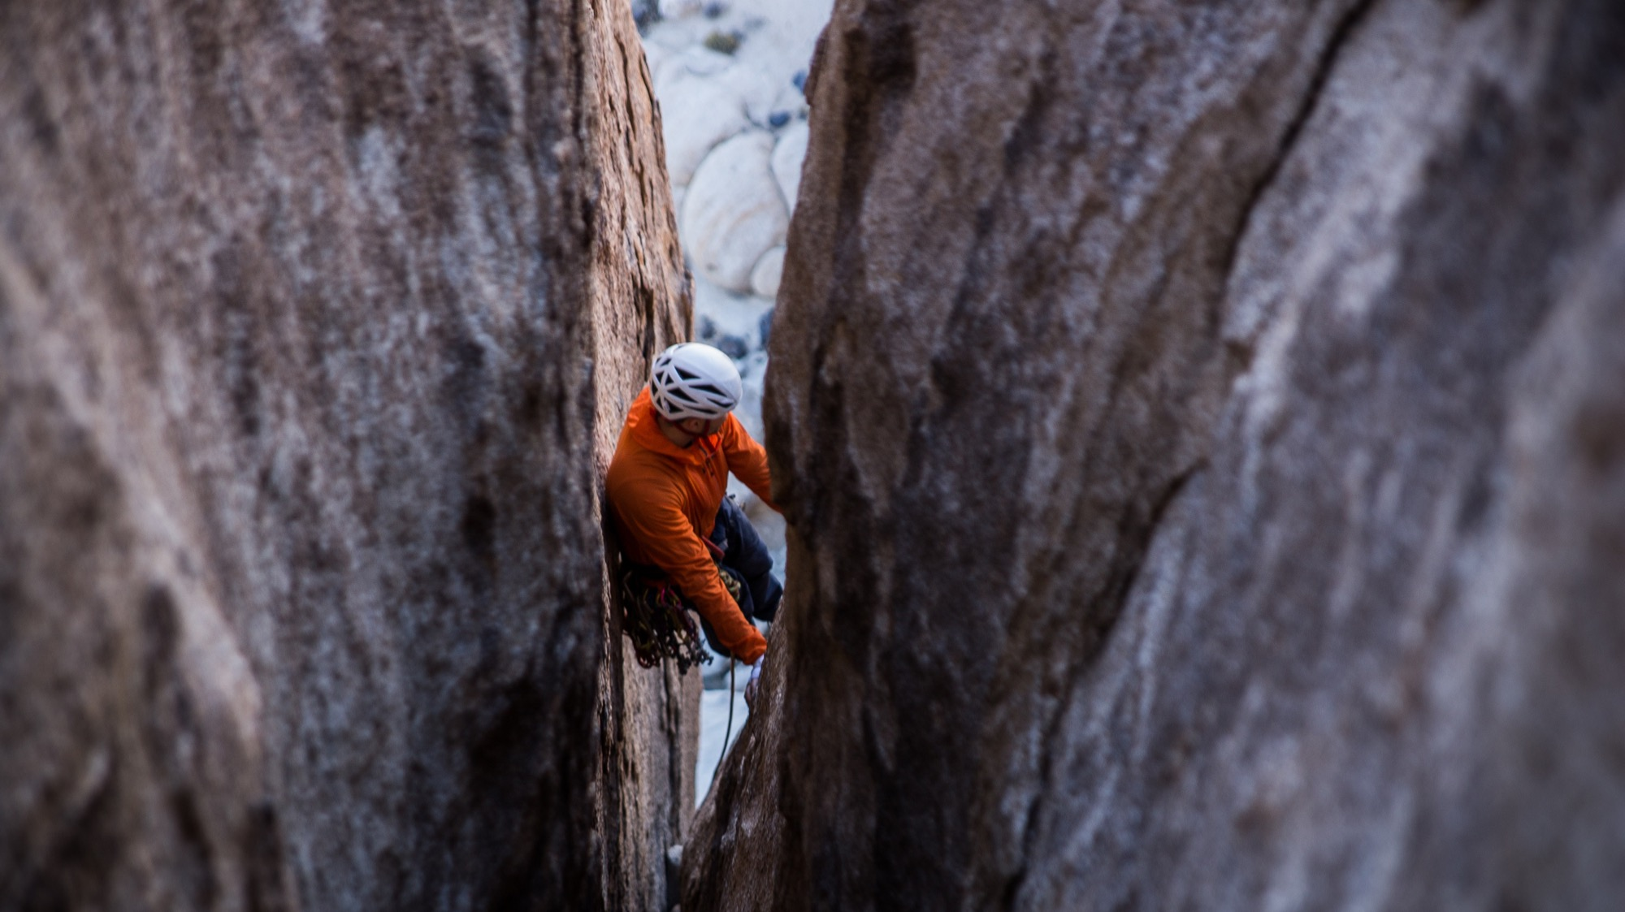
ADDITIONAL CHALLENGES

Slide 16
Top-rope rock climbing and rappelling on challenging yet achievable rock faces.
Every Team member will feel fear on the rock, a natural sense that can be overcome through Trust and Team Encouragement.
Team members will work together to insure safety, to support and assist other Teammates, under the watchful eyes of highly trained and experienced instructors.

Slide 17
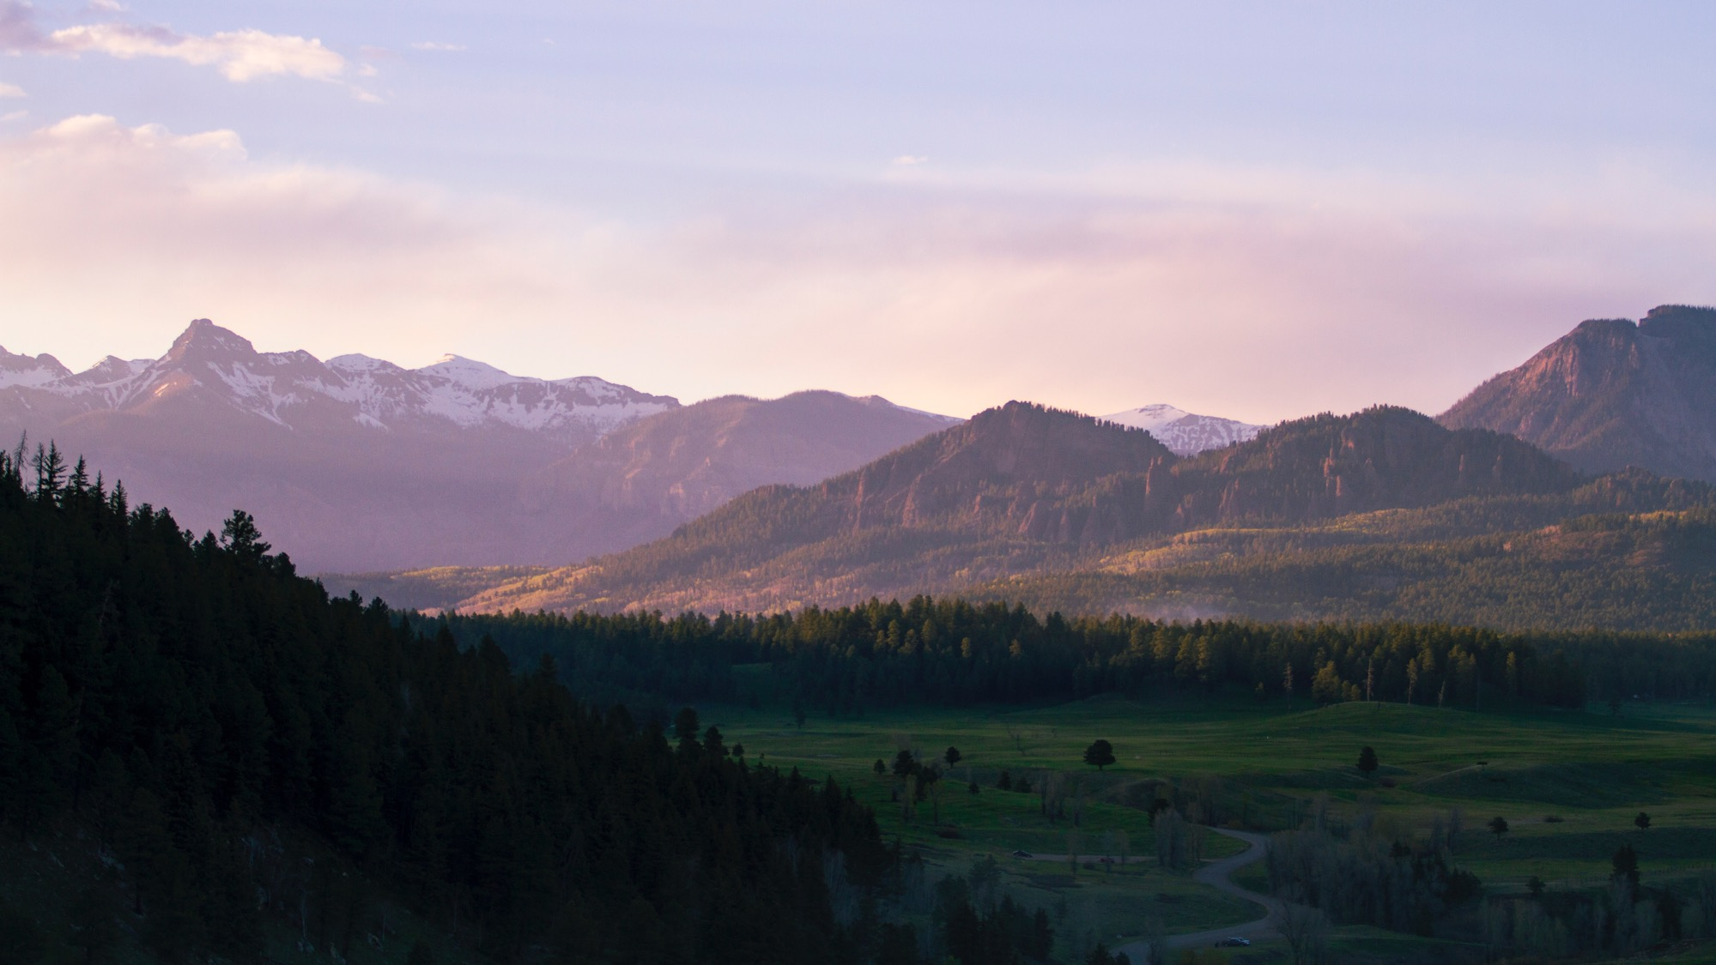
ITINERARY- 5 DAYS / 4 NIGHTS or custom-length to fit

Slide 18
Day 1: Arrive the Arkansas River Valley, transport to base camp or hotel, Huddle Orientatation
Day 2: Transfer to river launch site, safety lesson, full-day raft on the Arkansas river, camp
Day 3: Climbing instructions, top-rope rappelling, on-belay climbing, base camp, prep for Mtn Summit
Day 4: TEAM summit hike, weather permitting we will tackle 14,232’ Mt. Shavano, or another peak, head down to camp or hotel, celebration dinner, post-Experience Huddle
Day 5: Breakfast, head for home
(This could be adjusted to one less day if we eliminate the climbing/rappelling experience)

Slide 19
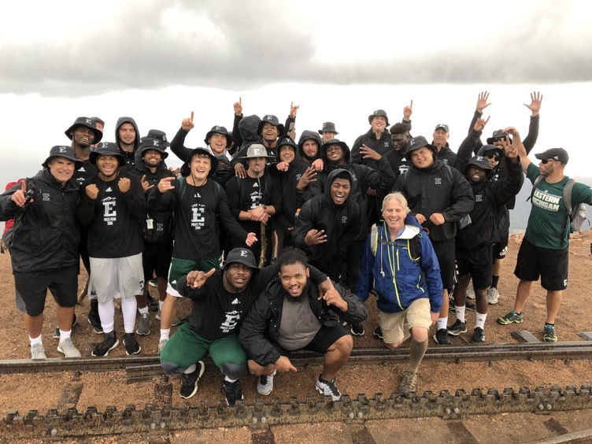
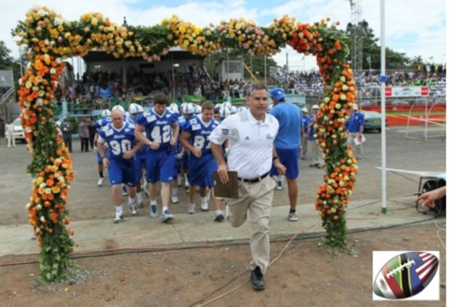
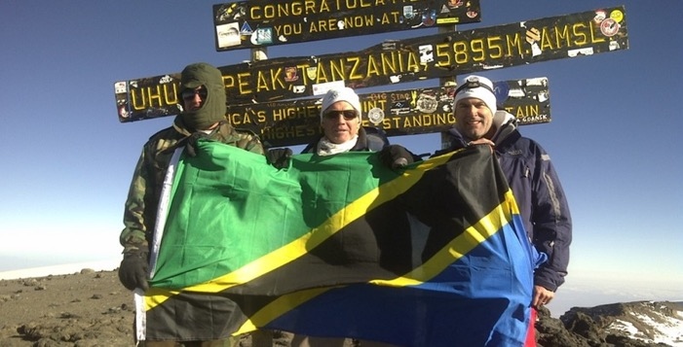
Kileleni Leadership Team
“Patrick and I have taken my football teams to Germany, Austria, Panama, and Tanzania on amazing trips that positively impacted everyone involved in all kinds of ways. We climbed mountains in both Austria and Tanzania and that experience alone made the trips worth it. The opportunity for leadership development in the Rocky Mountains will be incredible.
It is the perfect combination of his expertise and the difficult but attainable summit experience. I highly recommend developing your leaders through this unique opportunity.”
Chris Creighton, Head Football Coach, Eastern Michigan University

Slide 20
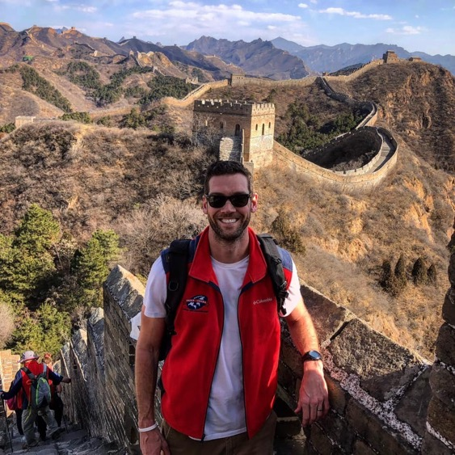
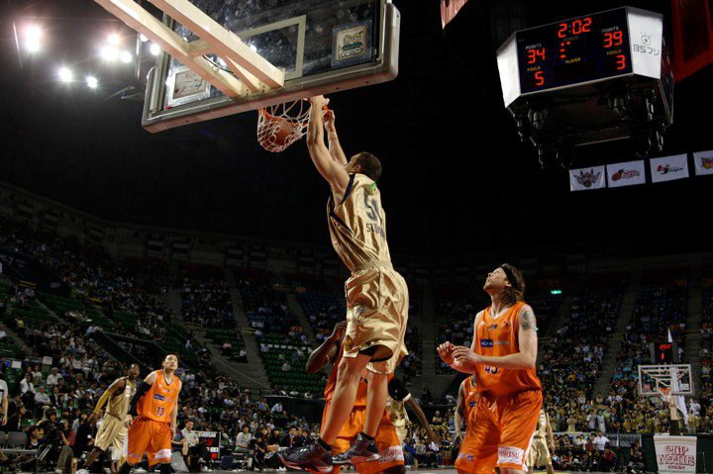
Kileleni Leadership Team
Global Football team member Kevin Steenberge
will work directly with clients designing and guiding customized
leadership Experiences.
An All-Conference player at the University of Richmond,
former professional basketball player, and graduate of
the Jepson School of Leadership Studies (B.A. ’06),
Kevin brings a unique understanding of leadership as
an athlete at the highest levels and in the world
beyond sports.

Slide 21
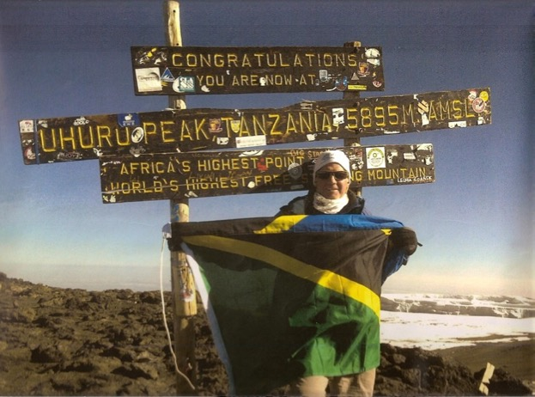
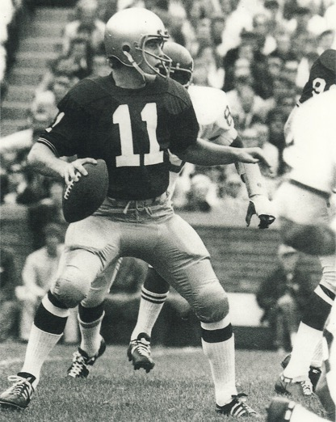
IN GOOD HANDS…
Global Football Founder & President
Patrick Steenberge will personally manage and lead
the Kileleni Leadership Experiences,
in partnership with Dvorak Expeditions,
Colorado’s 1st licensed outfitter.
A former Notre Dame quarterback under Ara Parseghian, Patrick has organized and led educational team sports tours in 28 countries on 6 continents since 1996.
Contact: Patrick Steenberge
patrick@globalfootball.com
817.219.7274

